Slide 1
2024 AHA/ACC/AMSSM/HRS/PACES/SCMR
Guideline for the Management of Hypertrophic Cardiomyopathy
A Report of the American Heart Association/American College of Cardiology Joint Committee on Clinical Practice Guidelines
Developed in Collaboration With and Endorsed by the American Medical Society for Sports Medicine, the Heart Rhythm Society, the Pediatric & Congenital Electrophysiology Society, and the Society for Cardiovascular Magnetic Resonance

Slide 2
Citation
This slide set is adapted from the 2024 AHA/ACC/AMSSM/HRS/PACES Guideline for the Management of Hypertrophic Cardiomyopathy. Published ahead of print May 8, 2024, available at: Circulation. https://www.ahajournals.org/doi/10.1161/CIR.0000000000001250 And Journal of the American College of Cardiology, published online ahead of print May 8, 2024. J Am Coll Cardiol. https://www.jacc.org/doi/10.1016/j.jacc.2024.02.014
© 2024 the American Heart Association, Inc. and the American College of Cardiology Foundation. All rights reserved. This article has been published in Circulation and the Journal of the American College of Cardiology.

Slide 3
2024 Writing Committee Members*
Steve R. Ommen, MD, FACC, Chair
Carolyn Y. Ho, MD, FAHA, Vice Chair
Irfan M. Asif, MD, FAMSSM†
Seshadri Balaji, MBBS, MRCP(UK), PhD, FHRS‡
Michael A. Burke, MD
Sharlene M. Day, MD, FAHA
Joseph A. Dearani, MD, FACC
Kelly C. Epps, MD, FACC
Lauren Evanovich, PhD§
Victor A. Ferrari, MD, FACC, FAHA║¶
José A. Joglar, MD, FACC, FAHA, MSCMR, FHRS
Sadiya S. Khan, MD, MSc, FACC, FAHA#
Jeffrey J. Kim, MD, FACC, FHRS**
Michelle M. Kittleson, MD, PhD, FACC, FAHA║
Chayakrit Krittanawong, MD††
Matthew W. Martinez, MD, FACC
Seema Mital, MD, FACC, FAHA
Srihari S. Naidu, MD, FACC, FAHA
Sara Saberi, MD, MS
Christopher Semsarian, MBBS, PhD, MPH, FHRS, FAHA
Sabrina Times, DHSC, MPH‡‡
Cynthia Burstein Waldman, JD§
*Writing committee members are required to recuse themselves from voting on sections to which their specific relationships with industry may apply; see Appendix 1 for detailed information. †AMSSM representative. ‡ HRS representative. §Lay stakeholder representative. ║AHA/ACC Joint Committee on Clinical Practice Guidelines liaison. ¶ SCMR representative; #ACC/AHA Joint Committee on Performance Measures representative. **PACES representative. ††ACC/AHA Joint Committee on Clinical Data Standards representative. ‡‡Joint ACC/AHA staff representative.

Slide 4
What Is New
New or Revised | Section Title | Recommendation in 2020 Guideline | COR in 2020 Guideline | Recommendation in 2024 Guideline | COR in 2024 Guideline
Revised | 6.5 Heart Rhythm Assessment | In patients with HCM who have additional risk factors for AF, such as left atrial dilatation, advanced age, and NYHA class III to class IV HF, and who are eligible for anticoagulation, extended ambulatory monitoring is reasonable to screen for AF as part of initial evaluation and periodic follow-up. | 2a | In patients with HCM who are deemed to be at high risk for developing AF based on the presence of risk factors or as determined by a validated risk score, and who are eligible for anticoagulation, extended ambulatory monitoring is recommended to screen for AF as part of initial evaluation and annual follow-up. | 1
New | 6.7 Exercise Stress Testing | N/A | N/A | In pediatric patients with HCM, regardless of symptom status, exercise stress testing is recommended to determine functional capacity and to provide prognostic information. | 1

Slide 5
What Is New (con’t.)
New or Revised | Section Title | Recommendation in 2020 Guideline | COR in 2020 Guideline | Recommendation in 2024 Guideline | COR in 2024 Guideline
Revised | 7.2 Patient Selection for ICD Placement | For patients ≥16 years of age with HCM and with ≥1 major SCD risk factors, discussion of the estimated 5-year sudden death risk and mortality rates can be useful during the shared decision-making process for ICD placement. | 2a | For patients with HCM with ≥1 major SCD risk factor, discussion of the estimated 5-year sudden death risk and mortality rates can be useful during the shared decision-making process for ICD placement. | 2a
Revised | 8.1.1 Pharmacological Management of Symptomatic Patients with Obstructive HCM | For patients with obstructive HCM who have persistent severe symptoms attributable to LVOTO despite beta blockers or nondihydropyridine calcium channel blockers, either adding disopyramide in combination with 1 of the other drugs, or SRT performed at experienced centers, is recommended. | 1 | For patients with obstructive HCM who have persistent symptoms attributable to LVOTO despite beta blockers or nondihydropyridine calcium channel blockers, adding a myosin inhibitors (adult patients only), or disopyramide (in combination with an atrioventricular nodal blocking agent), or SRT performed at experienced centers, is recommended. | 1

Slide 6
What Is New (con’t.)
New or Revised | Section Title | Recommendation in 2020 Guideline | COR in 2020 Guideline | Recommendation in 2024 Guideline | COR in 2024 Guideline
New | 8.2 Management of Patients With Nonobstructive HCM With Preserved EF | N/A | N/A | For younger (eg, ≤45 years of age) patients with nonobstructive HCM due to a pathogenic or likely pathogenic cardiac sarcomere genetic variant, and a mild phenotype, valsartan may be beneficial to slow adverse cardiac remodeling. | 2b
New | 8.3 Management of Patients With HCM and Advanced HF | N/A | N/A | In patients with HCM who develop persistent systolic dysfunction (LVEF <50%), cardiac myosin inhibitors should be discontinued. | 1

Slide 7
What Is New (con’t.)
New or Revised | Section Title | Recommendation in 2020 Guideline | COR in 2020 Guideline | Recommendation in 2024 Guideline | COR in 2024 Guideline
Revised | 9.1 Recreational Physical Activity and Competitive Athletics | For patients with HCM, participation in high-intensity recreational activities or moderate- to high-intensity competitive sports activities may be considered after a comprehensive evaluation and shared discussion, repeated annually with an expert provider who conveys that the risk of sudden death and ICD shocks may be increased, and with the understanding that eligibility decisions for competitive sports participation often involve third parties (eg, team physicians, consultants, and other institutional leadership) acting on behalf of the schools or teams. | 2b | For patients with HCM, participation in vigorous recreational activities is reasonable after an annual comprehensive evaluation and shared decision-making with an expert professional who balances potential benefits and risks. | 2a
 |  |  |  | For patients with HCM who are capable of a high level of physical performance, participation in competitive sports may be considered after review by an expert provider with experience managing athletes with HCM who conducts an annual comprehensive evaluation and shared decision-making that balances potential benefits and risks. | 2b

Slide 8
What Is New (con’t.)
New or Revised | Section Title | Recommendation in 2020 Guideline | COR in 2020 Guideline | Recommendation in 2024 Guideline | COR in 2024 Guideline
New | 9.1 Recreational Physical Activity and Competitive Athletics | N/A | N/A | For most patients with HCM, universal restriction from vigorous physical activity or competitive sports is not indicated. | 3: No Benefit
New | 9.3 Pregnancy in Patients With HCM | N/A | N/A | In pregnant women, use of mavacamten is contraindicated due to potential teratogenic effects. | 3: Harm

Slide 9
What Is New (con’t.)
AF indicates atrial fibrillation; COR, Class of Recommendation; EF, ejection fraction; HCM, hypertrophic cardiomyopathy; HF, heart failure; ICD, implantable cardioverter-defibrillator; LVEF, left ventricular ejection fraction; LVOTO, left ventricular outflow tract obstruction; N/A, not applicable; NYHA, New York Heart Association; SCD, sudden cardiac death; and SRT, septal reduction therapy.

Slide 10
Top 10 Take-Home Messages

Slide 11
Top 10 Take Home Messages
1. Shared decision-making is essential to provide the best clinical care. This involves thoughtful dialogue among patients, families, and their care team in which health care professionals present all available testing and treatment options; discuss the risks, benefits, and applicability of those options to the individual patient; and ensure the patient expresses their personal preferences and goals to develop their treatment plan.

Slide 12
Top 10 Take Home Messages
2. Although the primary cardiology team can initiate evaluation, treatment, and longitudinal care, referral to multidisciplinary hypertrophic cardiomyopathy (HCM) centers with appropriate expertise can be important to optimizing care for patients with HCM. Challenging treatment decisions—where reasonable alternatives exist, where the strength of recommendation is weak (eg, any decision relying on a Class of Recommendation 2b) or is particularly nuanced (eg, interpretation of genetic testing; primary prevention implantable cardioverter-defibrillator decision-making), and for HCM-specific invasive procedures—may critically benefit from involving specialized HCM centers.

Slide 13
Top 10 Take Home Messages
3. Careful ascertainment of family history, counseling patients with HCM about the potential for genetic transmission of HCM, and options for genetic testing are cornerstones of care. Screening first-degree family members of patients with HCM, using either genetic testing, serial imaging, or electrocardiographic surveillance as appropriate, can begin at any age and can be influenced by specifics of the patient and family history and family preference. Because screening recommendations for family members hinge on the pathogenicity of any detected variants, the reported pathogenicity should be reconfirmed every 2 to 3 years, and input from specialized HCM centers with genetics expertise may be valuable.

Slide 14
Top 10 Take Home Messages
4. Assessing a patient’s risk for sudden cardiac death is an important component of management. Integrating the presence or absence of established risk markers with tools to estimate individual risk score will facilitate the patient’s ability to participate in decision-making regarding implantable cardioverter-defibrillator placement. These discussions should incorporate a patient’s personal level of risk tolerance and their specific treatment goals.

Slide 15
Top 10 Take Home Messages
5. The risk factors for sudden cardiac death in children with HCM carry different weights and components than those used in adult patients. Pediatric risk stratification also varies with age and must account for different body sizes. Coupled with the complexity of placing implantable cardioverter-defibrillators in young patients with anticipated growth and a higher risk of device complications, the threshold for implantable cardioverter-defibrillator implantation in children often differs from adults. These differences are best addressed at comprehensive HCM centers with expertise in caring for children with HCM. New risk calculators, specific to children and adolescents, have been validated and can help young patients and their families contextualize their estimated risk of sudden cardiac death.

Slide 16
Top 10 Take Home Messages
6. Cardiac myosin inhibitors are now available to treat patients with symptomatic obstructive HCM. This new class of medication inhibits actin-myosin interaction, thus decreasing cardiac contractility and reducing left ventricular outflow tract obstruction. Mavacamten is currently the only U.S. Food and Drug Administration–approved agent. These agents can be beneficial for patients with obstructive HCM who do not derive adequate symptomatic relief from first-line drug therapy.

Slide 17
Top 10 Take Home Messages
7. Invasive septal reduction therapies (surgical septal myectomy and alcohol septal ablation), when performed by experienced HCM teams at dedicated centers, can provide safe and effective symptomatic relief for patients with drug-refractory or severe outflow tract obstruction. Given the data on the significantly improved outcomes at comprehensive HCM centers, these decisions represent an optimal opportunity for referral.

Slide 18
Top 10 Take Home Messages
8. Patients with HCM and persistent or paroxysmal atrial fibrillation have a sufficiently increased risk of stroke such that oral anticoagulation with direct-acting oral anticoagulants (or alternatively warfarin) should be considered the default treatment option irrespective of the CHA2DS2-VASc score. New tools to stratify risk for incident atrial fibrillation have been developed and may assist in determining the frequency of screening patients with ambulatory telemetry. Because rapid atrial fibrillation is often poorly tolerated in patients with HCM, maintenance of sinus rhythm and rate control are key treatment goals.

Slide 19
Top 10 Take Home Messages
9. Exercise stress testing is particularly helpful in determining overall exercise tolerance and for latent exercise provoked left ventricular outflow tract obstruction. Because children may not describe symptoms readily, routine exercise testing can be particularly important for young patients.

Slide 20
Top 10 Take Home Messages
10. Increasingly, data affirm that the beneficial effects of exercise on general health are extended to patients with HCM. Healthy recreational exercise (light [<3 metabolic equivalents], moderate [3–6 metabolic equivalents], and vigorous [>6 metabolic equivalents] intensity levels) has not been associated with increased risk of ventricular arrhythmia events in short-term studies. If patients pursue rigorous exercise training for the purpose of performance or competition, it is important to engage in a comprehensive discussion and seek input from expert HCM professionals regarding the potential risks and benefits, to develop an individualized training plan, and to establish a regular schedule for reevaluation.

Slide 21
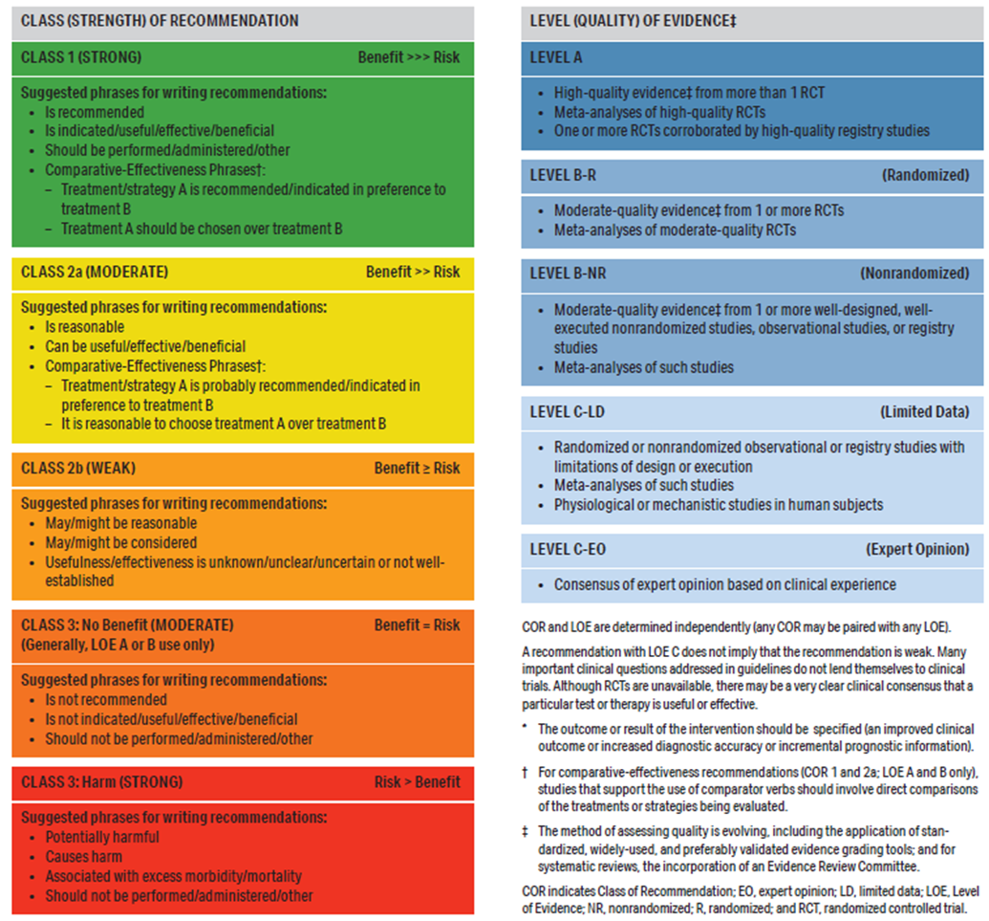
Table 2. Applying American College of Cardiology/American Heart Association Class of Recommendation and Level of Evidence to Clinical Strategies, Interventions, Treatments, or Diagnostic Testing in Patient Care* (Updated May 2019)

Slide 22
Shared Decision-Making

Slide 23
Shared Decision-Making
Recommendation for Shared Decision-Making Referenced studies that support the recommendation are summarized in the Online Data Supplement. | Recommendation for Shared Decision-Making Referenced studies that support the recommendation are summarized in the Online Data Supplement.
COR | LOE | Recommendation
1 | B-NR | For patients with HCM or at risk for HCM, shared decision-making is recommended in developing a plan of care (including, but not limited to, decisions regarding genetic evaluation, activity, lifestyle, and therapy choices) that includes a full disclosure of the risks, benefits, and anticipated outcomes of all options, as well the opportunity for the patient and caregivers to express their goals and concerns.

Slide 24
Multidisciplinary HCM Centers

Slide 25
Multidisciplinary HCM Centers
Recommendations for Multidisciplinary HCM Centers | Recommendations for Multidisciplinary HCM Centers
COR | LOE | Recommendations
1 | C-LD | In patients with HCM in whom SRT is indicated, the procedure should be performed at experienced centers (comprehensive or primary HCM centers) with demonstrated excellence in clinical outcomes for these procedures (Table 3, Table 4).
2a | C-LD | In patients with HCM, consultation with or referral to a comprehensive or primary HCM center is reasonable to aid in complex disease-related management decisions (Table 3).

Slide 26
Table 3. Suggested Competencies of Comprehensive and Primary HCM Centers
Potential HCM Care Delivery Competencies | Comprehensive HCM Center | Primary HCM Center | Referring Centers and Physicians
Diagnosis | X | X | X
Initial and surveillance TTE | X | X | X
Advanced echocardiographic imaging to detect latent LVOTO | X | X
Echocardiography to guide SRT | X | *
CMR imaging for diagnosis and risk stratification | X | X
Invasive evaluation for LVOTO | X | * | *
Coronary angiography | X | X | X
Stress testing for elicitation of LVOTO or consideration of advanced HF therapies and transplant | X | X
Counseling and performing family screening (imaging and genetic) | X | X | X
Genetic testing and counseling | X | X | *
SCD risk assessment | X | X | X
COR 1 and COR 2a ICD decision-making with adult patients | X | X | X
*Optional depending on the core competencies of the institution.
†If these procedures are performed, adequate quality assurance should be in place to demonstrate outcomes consistent with that achieved by comprehensive centers.
AF indicates atrial fibrillation; CMR, cardiovascular magnetic resonance; COR, Class of Recommendation; CRT, cardiac resynchronization therapy; HCM, hypertrophic cardiomyopathy; HF, heart failure; HFpEF, heart failure with preserved ejection fraction; HFrEF, heart failure with reduced ejection fraction; ICD, implantable cardioverter-defibrillator; LVOTO, left ventricular outflow tract obstruction; SCD, sudden cardiac death; and TTE, transthoracic echocardiography.

Slide 27
Table 3. Suggested Competencies of Comprehensive and Primary HCM Centers (con’t.)
Potential HCM Care Delivery Competencies | Comprehensive HCM Center | Primary HCM Center | Referring Centers and Physicians
COR 2b ICD decision-making with adult patients | X
ICD implantation (adults) | X | X | *
ICD decision-making and implantation with children and adolescents and their parents and caregivers | X | *
Initial AF management and stroke prevention | X | X | X
AF catheter ablation | X | X | *
Initial management of HFrEF and HFpEF | X | X | X
Advanced HF management (eg, transplantation, CRT) | X | *
Pharmacological therapy for HCM | X | X | X
Invasive management of symptomatic obstructive HCM | X | †
Counseling occupational and healthy living choices other than high-intensity or competitive activities | X | X | X
Counseling options on participation in high-intensity or competitive athletics | X
Managing women with HCM through pregnancy | X | *
Management of comorbidities | X | X | X
*Optional depending on the core competencies of the institution.
†If these procedures are performed, adequate quality assurance should be in place to demonstrate outcomes consistent with that achieved by comprehensive centers.
AF indicates atrial fibrillation; CMR, cardiovascular magnetic resonance; COR, Class of Recommendation; CRT, cardiac resynchronization therapy; HCM, hypertrophic cardiomyopathy; HF, heart failure; HFpEF, heart failure with preserved ejection fraction; HFrEF, heart failure with reduced ejection fraction; ICD, implantable cardioverter-defibrillator; LVOTO, left ventricular outflow tract obstruction; SCD, sudden cardiac death; and TTE, transthoracic echocardiography.

Slide 28
Table 4. Targets for Invasive Septal Reduction Therapies Outcomes
 | Rate (%)
 | Myectomy | Alcohol Septal Ablation
30-d mortality | ≤1 | ≤1
30-d adverse complications (tamponade, LAD dissection, infection, major bleeding) | ≤5 | ≤5
30-d complete heart block resulting in need for permanent pacemaker | ≤5 | ≤10
Mitral valve replacement within 1 y | ≤5
More than moderate residual mitral regurgitation | ≤5 | ≤5
Repeat procedure rate | ≤3 | ≤10
Symptomatic improvement (eg, ≥1 NYHA functional class) | >90 | >90
Rest and provoked LVOT gradient <50 mm Hg | >90 | >90
LAD indicates left anterior descending; LVOT, left ventricular outflow tract; and NYHA, New York Heart Association.

Slide 29
Diagnosis, Initial Evaluation, and Follow-Up

Slide 30
Clinical Diagnosis
Recommendation for Clinical Diagnosis Referenced studies that support the recommendation are summarized in the Online Data Supplement. | Recommendation for Clinical Diagnosis Referenced studies that support the recommendation are summarized in the Online Data Supplement.
COR | LOE | Recommendation
1 | B-NR | In patients with suspected HCM, comprehensive physical examination and complete medical and 3-generation family history is recommended as part of the initial diagnostic assessment (Table 5, Table 6).

Slide 31
Table 5. Clinical Features in Patients With HCM Phenocopies (Mimics)
Typical Presentation Age | Systemic Features | Possible Etiology | Diagnostic Approach
Infants (0-12 mo) and toddlers | Dysmorphic features, failure to thrive, metabolic acidosis | RASopathies Glycogen storage diseases, other metabolic or mitochondrial diseases Infant of a mother with diabetes | Geneticist assessment Newborn metabolic screening Specific metabolic assays Genetic testing
Early childhood | Delayed or abnormal cognitive development, visual or hearing impairment | RASopathies Mitochondrial diseases | Biochemical screening Genetic testing
Youth and adolescence | Skeletal muscle weakness or movement disorder | Friedreich’s ataxia Danon disease Mitochondrial disease | Biochemical screening Neuromuscular assessment Genetic testing
Adulthood | Movement disorder, peripheral neuropathy, renal dysfunction | Anderson-Fabry disease Friedreich’s ataxia infiltrative disorders (eg, amyloidosis) Glycogen storage diseases Mitochondrial disease | Biochemical screening Neuromuscular assessment Genetic testing

Slide 32
Table 6. Screening With Electrocardiography and 2D Echocardiography in Asymptomatic Family Members*
Age of First-Degree Relative | Initiation of Screening | Repeat ECG, Echo
Pediatric
Children and adolescents from genotype-positive families, and families with early onset disease | At the time HCM is diagnosed in another family member | Every 1-2 y
All other children and adolescents | At any time after HCM is diagnosed in a family member but no later than puberty | Every 2-3 y
Adults | At the time HCM is diagnosed in another family member | Every 3-5 y
*Includes all asymptomatic, phenotype-negative, first-degree relatives deemed to be at-risk for developing HCM based on family history or genotype status and may sometimes include more distant relatives based on clinical judgment. Screening interval may be modified (eg, at onset of new symptoms or in families with a malignant clinical course or late-onset HCM).
ECG indicates electrocardiogram; Echo, echocardiogram; and HCM, hypertrophic cardiomyopathy.

Slide 33
Echocardiography
Recommendations for Echocardiography Referenced studies that support the recommendations are summarized in the Online Data Supplement. | Recommendations for Echocardiography Referenced studies that support the recommendations are summarized in the Online Data Supplement.
COR | LOE | Recommendations
1 | B-NR | In patients with suspected HCM, a transthoracic echocardiogram (TTE) is recommended in the initial evaluation.
1 | B-NR (children) | In patients with HCM who have no change in clinical status or events, repeat TTE is recommended every 1 to 2 years to assess the degree of myocardial hypertrophy, dynamic LVOTO, MR, and myocardial function (Figure 1).
 | C-LD (adults)
1 | B-NR | For patients with HCM who experience a change in clinical status or a new clinical event, repeat TTE is recommended.
1 | B-NR | For patients with HCM and resting peak LVOT gradient <50 mm Hg, a TTE with provocative maneuvers is recommended.

Slide 34
Echocardiography (con’t.)
1 | B-NR | For symptomatic patients with HCM who do not have a resting or provocable outflow tract peak gradient ≥50 mm Hg on TTE, exercise TTE is recommended for the detection and quantification of dynamic LVOTO.
1 | B-NR | For patients with HCM who are undergoing surgical septal myectomy, intraoperative transesophageal echocardiogram (TEE) is recommended to assess mitral valve anatomy and function and adequacy of septal myectomy.
1 | B-NR | For patients with HCM who are undergoing alcohol septal ablation, TTE or intraoperative TEE with intracoronary ultrasound-enhancing contrast injection of the candidate’s septal perforator(s) is recommended.
1 | B-NR | For patients with HCM who have undergone SRT, TTE within 3 to 6 months after the procedure is recommended to evaluate the procedural results.
1 | B-NR | Screening: In first-degree relatives of patients with HCM, a TTE is recommended as part of initial family screening and periodic follow- up (Figure 1, Table 6).

Slide 35
Echocardiography (con’t.)
1 | B-NR | Screening: In individuals who are genotype-positive, phenotype-negative, echocardiography is recommended at periodic intervals depending on age (1 to 2 years in children and adolescents, 3 to 5 years in adults) and change in clinical status (Figure 1, Table 6).
2a | C-LD | For patients with HCM, TEE can be useful if TTE is inconclusive in clinical decision-making regarding medical therapy, and in situations such as planning for myectomy, exclusion of subaortic membrane or MR secondary to structural abnormalities of the mitral valve apparatus, or in the assessment of the feasibility of alcohol septal ablation.
2a | B-NR | For patients with HCM in whom the diagnosis of apical HCM, apical aneurysm, or atypical patterns of hypertrophy is inconclusive on TTE, the use of an intravenous ultrasound-enhancing agent is reasonable, particularly if other imaging modalities such as CMR are not readily available or are contraindicated.
2a | C-LD | For asymptomatic patients with HCM who do not have a resting or provocable outflow tract peak gradient ≥50 mm Hg on standard TTE, exercise TTE is reasonable for the detection and quantification of dynamic LVOTO.

Slide 36
CMR Imaging
Recommendations for CMR Imaging Referenced studies that support the recommendations are summarized in the Online Data Supplement. | Recommendations for CMR Imaging Referenced studies that support the recommendations are summarized in the Online Data Supplement.
COR | LOE | Recommendations
1 | B-NR | For patients suspected of having HCM in whom echocardiography is inconclusive, CMR imaging is indicated for diagnostic clarification.
1 | B-NR | For patients with LVH in whom there is a suspicion of alternative diagnoses, including infiltrative or storage disease as well as athlete’s heart, CMR imaging is useful (Figure 1).

Slide 37
CMR Imaging (con’t.)
1 | B-NR | For patients with HCM who are not otherwise identified as high risk for SCD, or in whom a decision to proceed with ICD remains uncertain after clinical assessment that includes personal or family history, echocardiography, and ambulatory electrocardiographic monitoring, CMR imaging is beneficial to assess for maximum LV wall thickness, EF, LV apical aneurysm, and extent of myocardial replacement fibrosis with late gadolinium enhancement (LGE).
1 | B-NR | For patients with obstructive HCM in whom the anatomic mechanism of obstruction is inconclusive on echocardiography, CMR imaging is indicated to inform the selection and planning of SRT.
2b | C-EO | For patients with HCM, repeat contrast-enhanced CMR imaging on a periodic basis (every 3 to 5 years) for the purpose of SCD risk stratification may be considered to evaluate changes in LGE and other morphologic changes, including EF, development of apical aneurysm, or LV wall thickness (Figure 1, Table 7).

Slide 38
Cardiac CT
Recommendation for Cardiac CT | Recommendation for Cardiac CT
COR | LOE | Recommendation
2b | C-LD | In adult patients with suspected HCM, cardiac CT may be considered for diagnosis if the echocardiogram is not diagnostic and CMR imaging is unavailable.

Slide 39
Heart Rhythm Assessment
Recommendations for Heart Rhythm Assessment Referenced studies that support the recommendations are summarized in the Online Data Supplement. | Recommendations for CMR Imaging Referenced studies that support the recommendations are summarized in the Online Data Supplement.
COR | LOE | Recommendations
1 | B-NR | In patients with HCM, a 12-lead ECG is recommended in the initial evaluation and as part of periodic follow-up (every 1 to 2 years) (Figure 1, Table 6).
1 | B-NR | In patients with HCM, 24- to 48-hour ambulatory electrocardiographic monitoring is recommended in the initial evaluation and as part of periodic follow-up (every 1 to 2 years) to identify patients who are at risk for SCD and to guide management of arrhythmias (Figure 1).

Slide 40
Heart Rhythm Assessment (con’t.)
1 | B-NR | In patients with HCM who develop palpitations or lightheadedness, extended (>24 hours) electrocardiographic monitoring or event recording is recommended for arrhythmia diagnosis and clinical correlation.
1 | B-NR | In first-degree relatives of patients with HCM, a 12-lead ECG is recommended as a component of the screening algorithm (Figure 1, Table 6).
1 | B-NR | In patients with HCM who are deemed to be at high risk for developing AF based on the presence of risk factors or as determined by a validated risk score, and who are eligible for anticoagulation, extended ambulatory monitoring is recommended to screen for AF as part of initial evaluation and annual follow-up (Figure 1).
2b | B-NR | In adult patients with HCM without risk factors for AF and who are eligible for anticoagulation, extended ambulatory monitoring may be considered to assess for asymptomatic paroxysmal AF as part of initial evaluation and periodic follow-up (every 1 to 2 years).

Slide 41
Angiography and Invasive Hemodynamic Assessment
Recommendations for Angiography and Invasive Hemodynamic Assessment Referenced studies that support the recommendations are summarized in the Online Data Supplement. | Recommendations for Angiography and Invasive Hemodynamic Assessment Referenced studies that support the recommendations are summarized in the Online Data Supplement.
COR | LOE | Recommendations
1 | B-NR | For patients with symptomatic HCM for whom there is uncertainty regarding the presence or severity of LVOTO on noninvasive imaging studies, invasive hemodynamic assessment with cardiac catheterization is recommended.
1 | B-NR | In patients with HCM who have symptoms or evidence of myocardial ischemia, coronary angiography (CT or invasive) is recommended.
1 | B-NR | In patients with HCM who are at risk of coronary atherosclerosis, coronary angiography (CT or invasive) is recommended before surgical myectomy.

Slide 42
Exercise Stress Testing
Recommendations for Exercise Stress Testing Referenced studies that support the recommendations are summarized in the Online Data Supplement. | Recommendations for Exercise Stress Testing Referenced studies that support the recommendations are summarized in the Online Data Supplement.
COR | LOE | Recommendations
1 | B-NR | For symptomatic patients with HCM who do not have resting or provocable outflow tract peak gradient ≥50 mm Hg on TTE, exercise TTE is recommended for the detection and quantification of dynamic LVOTO.
1 | B-NR | In patients with nonobstructive HCM and advanced HF (NYHA functional class III to class IV), cardiopulmonary exercise stress testing should be performed to quantify the degree of functional limitation and aid in selection of patients for heart transplantation or mechanical circulatory support.
1 | B-NR | In pediatric patients with HCM, regardless of symptom status, exercise stress testing is recommended to determine functional capacity and to provide prognostic information.

Slide 43
Exercise Stress Testing (con’t.)
2a | B-NR | In adult patients with HCM, exercise stress testing is reasonable to determine functional capacity and to provide prognostic information as part of initial evaluation.
2a | C-LD | For asymptomatic patients with HCM who do not have a resting or provocable outflow tract peak gradient ≥50 mm Hg on standard TTE, exercise TTE is reasonable for the detection and quantification of dynamic LVOTO.
2b | C-LD | 6. In patients with obstructive HCM and ambiguous functional capacity, exercise stress testing may be reasonable to guide therapy (Figure 1).
2b | C-EO | 7. In patients with HCM for whom it is unclear if their functional capacity has declined, exercise stress testing may be considered every 2 to 3 years (Figure 1).

Slide 44
Genetics and Family Screening
Recommendations for Genetics and Family Screening Referenced studies that support the recommendations are summarized in the Online Data Supplement. | Recommendations for Genetics and Family Screening Referenced studies that support the recommendations are summarized in the Online Data Supplement.
COR | LOE | Recommendations
1 | B-NR | In patients with HCM, evaluation of familial inheritance, including a 3-generation family history, is recommended as part of the initial assessment.
1 | B-NR | In patients with HCM, genetic testing is beneficial to elucidate the genetic basis to facilitate the identification of family members at risk for developing HCM (cascade testing).
1 | B-NR | In patients with an atypical clinical presentation of HCM or when another genetic condition is suspected to be the cause, a workup including genetic testing for HCM and other genetic causes of unexplained cardiac hypertrophy (“HCM phenocopies”) is recommended.
1 | B-NR | In patients with HCM, genetic counseling by an expert in the genetics of cardiovascular disease is recommended so that risks, benefits, test results, and their clinical significance can be reviewed and discussed with the patient in a shared decision-making process.
1 | B-NR | When performing genetic testing in a proband with HCM, the initial tier of genes tested should include genes with strong evidence to be disease-causing in HCM.*
*Strong evidence HCM genes include, at the time of this publication: MYH7, MYBPC3, TNNI3, TNNT2, TPM1, MYL2, MYL3, and ACTC1

Slide 45
Genetics and Family Screening (con’t.)
1 | B-NR | In first-degree relatives of patients with HCM, both clinical screening (ECG and 2D echocardiogram) and cascade genetic testing (when a pathogenic/likely pathogenic variant has been identified in the proband) should be offered.
1 | B-NR | In families where a sudden unexplained death has occurred with a postmortem diagnosis of HCM, postmortem genetic testing is beneficial to facilitate cascade genetic testing and clinical screening in first-degree relatives.
1 | B-NR | In patients with HCM who have undergone genetic testing, serial reevaluation of the clinical significance of the variant(s) identified is recommended to assess for variant reclassification, which may impact diagnosis and cascade genetic testing in family members (Figure 1, Figure 2).
1 | B-NR | In affected families with HCM, preconception and prenatal reproductive and genetic counseling should be offered.
2b | B-NR | In adult patients with HCM, the usefulness of genetic testing in the assessment of risk of SCD is uncertain.
2b | B-NR | In patients with HCM who have a variant of uncertain significance (VUS), the usefulness of clinical genetic testing of phenotype-negative relatives for the purpose of variant reclassification is uncertain.

Slide 46
Genetics and Family Screening (con’t.)
3: No benefit | B-NR | For patients with HCM who have undergone genetic testing and were found to have no pathogenic variants (ie, harbor only benign or likely benign variants), cascade genetic testing of the family is not useful.
3: No benefit | B-NR | Ongoing clinical screening is not indicated in genotype-negative relatives in families with genotype-positive HCM, unless the disease-causing variant is downgraded to a VUS, likely benign, or benign variant during follow-up.

Slide 47
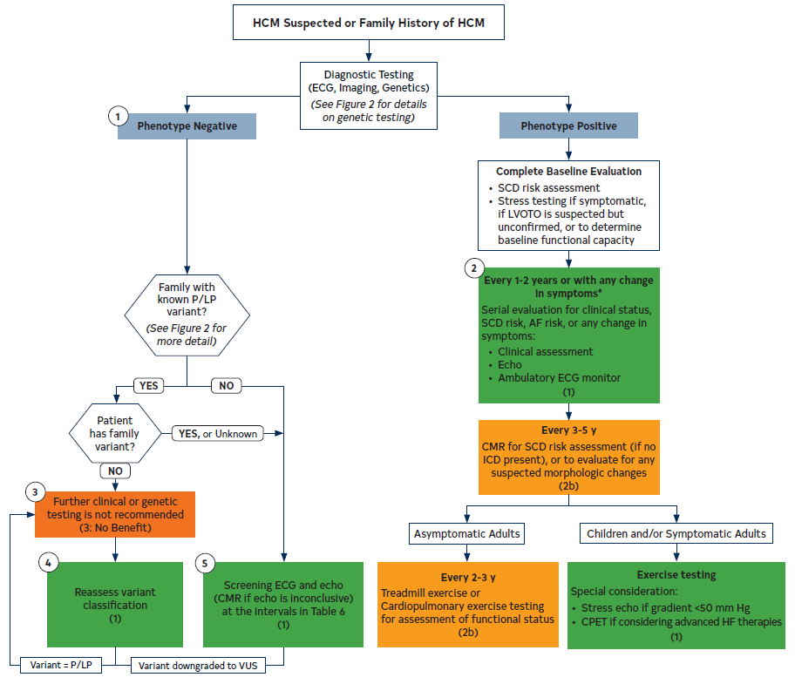
Figure 1. Recommended Evaluation and Testing for HCM.
Colors correspond to Table 2.
*The interval may be extended, particularly in adult patients who remain stable after multiple evaluations
AF indicates atrial fibrillation; CMR, cardiovascular magnetic resonance; CPET, cardiopulmonary exercise test; ECG, electrocardiography/electrocardiogram; echo, echocardiography/echocardiogram; HCM, hypertrophic cardiomyopathy; HF, heart failure; ICD, implantable cardioverter-defibrillator; LVOTO, left ventricular outflow tract obstruction; P/LP, pathogenic or likely pathogenic variant; SCD, sudden cardiac death; and VUS, variant of unknown significance.

Slide 48
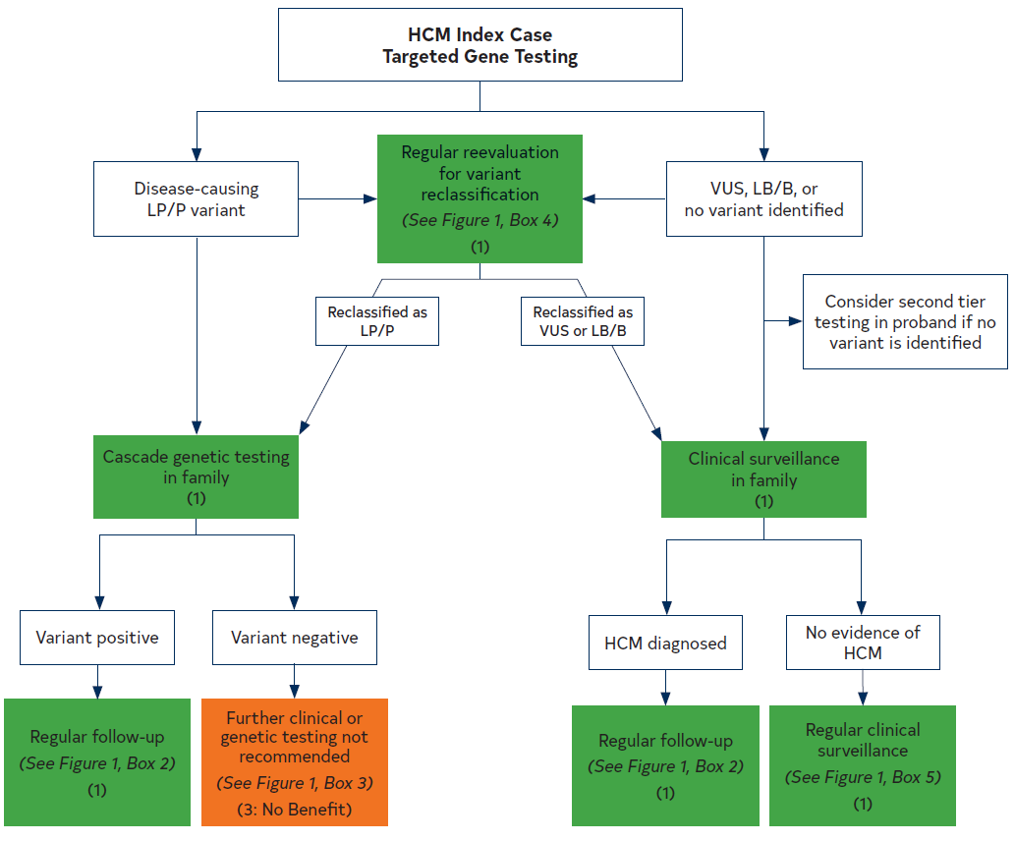
Figure 2. Genetic Testing Process in HCM.
Colors correspond to Table 2.
HCM indicates hypertrophic cardiomyopathy; LB/B, likely benign/benign; LP/P, likely pathogenic or pathogenic; and VUS, variant of unknown significance.

Slide 49
Individuals Who Are Genotype-Positive, Phenotype-Negative
Recommendations for Individuals Who Are Genotype-Positive, Phenotype-Negative Referenced studies that support the recommendations are summarized in the Online Data Supplement. | Recommendations for Individuals Who Are Genotype-Positive, Phenotype-Negative Referenced studies that support the recommendations are summarized in the Online Data Supplement.
COR | LOE | Recommendations
1 | B-NR | In individuals who are genotype-positive, phenotype-negative for HCM, serial clinical assessment, electrocardiography, and cardiac imaging are recommended at periodic intervals depending on age (every 1 to 2 years in children and adolescents and every 3 to 5 years in adults) and change in clinical status (Figure 1, Figure 2, Table 6).
2a | B-NR | In individuals who are genotype-positive, phenotype-negative for HCM, participation in competitive sports of any intensity is reasonable.
3: No benefit | B-NR | In individuals who are genotype-positive, phenotype-negative for HCM, ICD is not recommended for primary prevention.

Slide 50
SCD Risk Assessment and Prevention

Slide 51
SCD Risk Assessment in Adults With HCM
Recommendations for SCD Risk Assessment in Adults With HCM Referenced studies that support the recommendations are summarized in the Online Data Supplement. | Recommendations for SCD Risk Assessment in Adults With HCM Referenced studies that support the recommendations are summarized in the Online Data Supplement.
COR | LOE | Recommendations
1 | B-NR | In adult patients with HCM, a comprehensive, systematic noninvasive SCD risk assessment at initial evaluation and every 1 to 2 years thereafter is recommended and should include evaluation of these risk factors (Figure 1, Figure 3, Table 7): Personal history of cardiac arrest or sustained ventricular arrhythmias; Personal history of syncope suspected by clinical history to be arrhythmic; Family history in close relative of premature HCM-related sudden death, cardiac arrest, or sustained ventricular arrhythmias; Maximal LV wall thickness, EF, LV apical aneurysm; NSVT episodes on continuous ambulatory electrocardiographic monitoring.

Slide 52
SCD Risk Assessment in Adults With HCM (con’t.)
1 | B-NR | For adult patients with HCM who are not otherwise identified as high risk for SCD, or in whom a decision to proceed with ICD placement remains uncertain after clinical assessment that includes personal/family history, echocardiography, and ambulatory electrocardiographic monitoring, CMR imaging is beneficial to assess for maximum LV wall thickness, EF, LV apical aneurysm, and extent of myocardial fibrosis with LGE (Table 7).
2a | B-NR | For patients who are ≥16 years of age with HCM, it is reasonable to obtain echocardiography-derived left atrial diameter and maximal LVOT gradient to aid in calculating an estimated 5-year sudden death risk that may be useful during shared decision-making for ICD placement (Table 7).

Slide 53
SCD Risk Assessment in Children and Adolescents With HCM
Recommendations for SCD Risk Assessment in Children and Adolescents With HCM Referenced studies that support the recommendations are summarized in the Online Data Supplement. | Recommendations for SCD Risk Assessment in Children and Adolescents With HCM Referenced studies that support the recommendations are summarized in the Online Data Supplement.
COR | LOE | Recommendations
1 | B-NR | For children and adolescents with HCM, a comprehensive, systematic noninvasive SCD risk assessment at initial evaluation and every 1 to 2 years thereafter is recommended and should include evaluation of these risk factors (Figure 1, Figure 3, Table 7): Personal history of cardiac arrest or sustained ventricular arrhythmias; Personal history of syncope suspected by clinical history to be arrhythmic; Family history in close relative of premature HCM-related sudden death, cardiac arrest, or sustained ventricular arrhythmias; Maximal LV wall thickness, EF, LV apical aneurysm; NSVT episodes on continuous ambulatory electrocardiographic monitoring.

Slide 54
SCD Risk Assessment in Children and Adolescents With HCM (con’t.)
1 | C-LD | For children and adolescents with HCM who have a borderline risk for SCD, or in whom a decision to proceed with ICD placement remains uncertain after clinical assessment that includes personal and family history, echocardiography, and ambulatory electrocardiographic monitoring, CMR imaging is beneficial to assess for extent of myocardial fibrosis with LGE (Table 7).
2a | B-NR | For patients <16 years of age with HCM, it is reasonable to calculate an estimated 5-year sudden death risk that includes echocardiographic parameters (interventricular septal thickness in diastole, LV posterior wall thickness in end-diastole, left atrial diameter, maximal LVOT gradient) and genotype, which may be useful during shared decision-making for ICD placement (Table 7).

Slide 55
Table 7. Clinical Sudden Death Risk Factors for Adults and Children With HCM
Family history of sudden death from HCM | Sudden death judged definitively or likely attributable to HCM in ≥1 first-degree or close relatives who are ≤50 y of age. Close relatives would generally be second-degree relatives; however, multiple SCDs in tertiary relatives should also be considered relevant.
Massive LVH | Wall thickness ≥30 mm in any segment within the chamber by echocardiography or CMR imaging; consideration for this morphologic marker is also given to borderline values of ≥28 mm in individual patients at the discretion of the treating cardiologist. For pediatric patients with HCM, an absolute or z-score threshold for wall thickness has not been established; however, a maximal wall thickness that corresponds to a z-score ≥20 (and >10 in conjunction with other risk factors) appears reasonable.
Unexplained syncope | ≥1 unexplained episodes involving acute transient loss of consciousness, judged by history unlikely to be of neurocardiogenic (vasovagal) etiology, not attributable to LVOTO, and especially when occurring within 6 mo of evaluation (events beyond 5 y in the past do not appear to have relevance).
HCM with LV systolic dysfunction | Systolic dysfunction with EF <50% by echocardiography or CMR imaging.
CMR indicates cardiovascular magnetic resonance; ICD, implantable cardioverter-defibrillator; LGE, late gadolinium enhancement; LV, left ventricular; LVH, left ventricular hypertrophy; LVOTO, left ventricular outflow tract obstruction; NSVT, nonsustained ventricular tachycardia; SCD, sudden cardiac death; and VT, ventricular tachycardia.

Slide 56
Table 7. Clinical Sudden Death Risk Factors for Adults and Children With HCM (con’t.)
LV apical aneurysm | Apical aneurysm defined as a discrete thin-walled dyskinetic or akinetic segment with transmural scar or LGE of the most distal portion of the LV chamber, independent of size. (In children, apical aneurysm is uncommon, and the risk has not been studied.)
Extensive LGE on CMR imaging | Extensive LGE, representing replacement fibrosis, either quantified or estimated by visual inspection, comprising ≥15% of LV mass (extent of LGE conferring risk has not been defined in children).
NSVT on ambulatory monitor | ≥3 beats at ≥120 bpm has generally been used in studies. It would seem most appropriate to place greater weight on NSVT as a risk marker when runs are frequent (eg, ≥3), longer (eg, ≥10 beats), or faster (eg, ≥200 bpm) occurring usually over 24 to 48 h of monitoring. For pediatric patients, a VT rate that exceeds the baseline sinus rate by >20% is considered significant.
Genotype status | Genotype-positive status (ie, harboring a putatively disease-causing pathogenic/likely pathogenic variant) is associated with higher SCD risk in pediatric HCM patients.
BPM indicates beats per min; CMR indicates cardiovascular magnetic resonance; ICD, implantable cardioverter-defibrillator; LGE, late gadolinium enhancement; LV, left ventricular; LVH, left ventricular hypertrophy; LVOTO, left ventricular outflow tract obstruction; NSVT, nonsustained ventricular tachycardia; SCD, sudden cardiac death; and VT, ventricular tachycardia.

Slide 57
Patient Selection for ICD Placement
Recommendations for ICD Placement in High-Risk Patients With HCM Referenced studies that support the recommendations are summarized in the Online Data Supplement. | Recommendations for ICD Placement in High-Risk Patients With HCM Referenced studies that support the recommendations are summarized in the Online Data Supplement.
COR | LOE | Recommendations
1 | C-EO | In patients with HCM, application of individual clinical judgment is recommended when assessing the prognostic strength of conventional risk marker(s) within the clinical profile of the individual patient, as well as a thorough and balanced discussion of the evidence, benefits, and estimated risks to engage the fully informed patient’s active participation in ICD decision-making.
1 | B-NR | For patients with HCM and previous documented cardiac arrest or sustained VT, ICD placement is recommended (Figure 3, Table 7).
2a | B-NR | For adult patients with HCM with ≥1 major risk factors for SCD, it is reasonable to offer an ICD. These major risk factors include (Figure 3, Table 7): Sudden death judged definitively or likely attributable to HCM in ≥1 first-degree or close relatives who are ≤50 years of age; Massive LVH ≥30 mm in any LV segment; ≥1 recent episodes of syncope suspected by clinical history to be arrhythmic (ie, unlikely to be of neurocardiogenic [vasovagal] etiology, or related to LVOTO); LV apical aneurysm with transmural scar or LGE; LV systolic dysfunction (EF <50%).

Slide 58
Patient Selection for ICD Placement (con’t.)
2a | B-NR | For children with HCM who have ≥1 conventional risk factors, including unexplained syncope, massive LVH, NSVT, or family history of early HCM-related SCD, ICD placement is reasonable after considering the relatively high complication rates of long-term ICD placement in younger patients (Figure 3, Table 7).
2a | B-NR | For patients with HCM with ≥1 major SCD risk factor, discussion of the estimated 5-year sudden death risk and mortality rates can be useful during the shared decision-making process for ICD placement (Figure 3, Table 7).
2b | B-NR | In select adult patients with HCM and without major SCD risk factors after clinical assessment, or in whom the decision to proceed with ICD placement remains otherwise uncertain, ICD may be considered in patients with extensive LGE by contrast-enhanced CMR imaging or NSVT present on ambulatory monitoring (Figure 3, Table 7).
2b | B-NR | In pediatric patients with HCM, it can be useful to consider additional factors such as extensive LGE on contrast-enhanced CMR imaging and systolic dysfunction in risk stratification for ICD shared decision-making (Figure 3, Table 7).
3: Harm | B-NR | In patients with HCM without risk factors, ICD placement should not be performed.
3: Harm | B-NR | In patients with HCM, ICD placement for the sole purpose of participation in competitive athletics should not be performed.

Slide 59
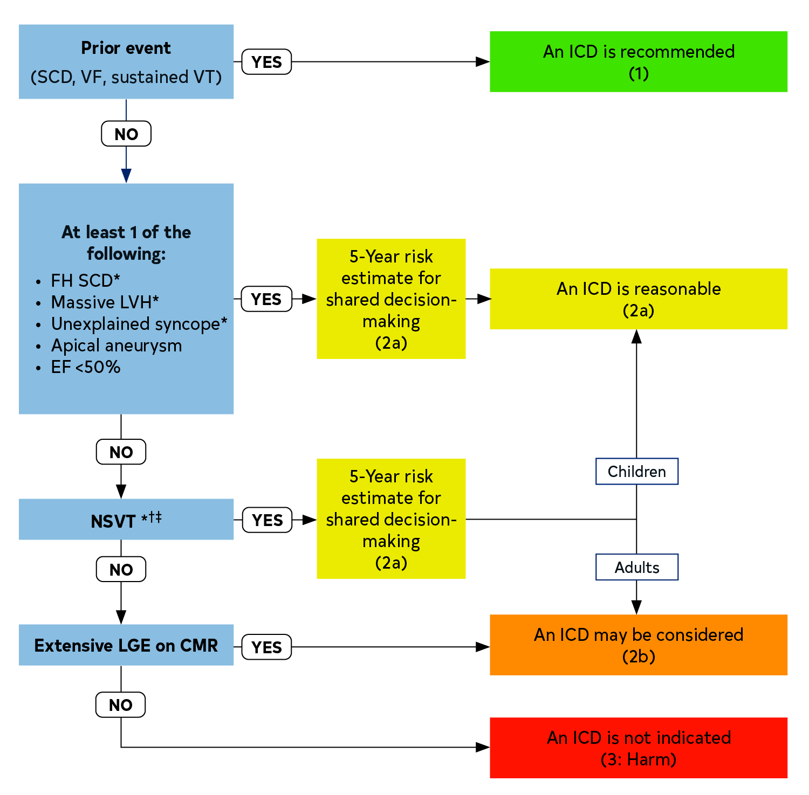
Figure 3. Patient Selection for ICD Use.
Colors correspond to Table 2.
*ICD decisions in pediatric patients with HCM are based on ≥1 of these major risk factors: family history of HCM SCD, NSVT on ambulatory monitor, massive LVH, and unexplained syncope.
†5-Year risk estimates can be considered to fully inform patients during shared decision-making discussions.
‡It would seem most appropriate to place greater weight on frequent, longer, and faster runs of NSVT.
CMR indicates cardiovascular magnetic resonance; EF, ejection fraction; FH, family history; HCM, hypertrophic cardiomyopathy; ICD, implantable cardioverter-defibrillator; LGE, late gadolinium enhancement; LVH, left ventricular hypertrophy; NSVT, nonsustained ventricular tachycardia; SCD, sudden cardiac death; VF, ventricular fibrillation; and VT, ventricular tachycardia.

Slide 60
ICD Device Selection Considerations
Recommendations for ICD Device Selection Considerations Referenced studies that support the recommendations are summarized in the Online Data Supplement. | Recommendations for ICD Device Selection Considerations Referenced studies that support the recommendations are summarized in the Online Data Supplement.
COR | LOE | Recommendations
1 | B-NR | In patients with HCM who are receiving an ICD, either a single chamber transvenous ICD or a subcutaneous ICD is recommended after a shared decision-making discussion that takes into consideration patient preferences, age, lifestyle, and potential need for pacing for bradycardia or VT termination.
1 | B-NR | In patients with HCM who are receiving a transvenous ICD, single-coil ICD leads are recommended in preference to dual-coil leads, if defibrillation threshold is deemed adequate.

Slide 61
ICD Device Selection Considerations (con’t.)
2a | B-NR | In patients with HCM who are receiving an ICD, dual-chamber ICDs are reasonable for patients with a need for atrial or atrioventricular sequential pacing for bradycardia/conduction abnormalities, or as an attempt to relieve symptoms of obstructive HCM (most commonly in patients >65 years of age).
2a | C-LD | In selected adult patients with nonobstructive HCM receiving an ICD who have NYHA class II to ambulatory class IV HF, left bundle branch block (LBBB), and LVEF <50%, cardiac resynchronization therapy (CRT) for symptom reduction is reasonable.
2b | C-LD | In patients with HCM in whom a decision has been made for ICD implantation and who have paroxysmal atrial tachycardias or AF, dual-chamber ICDs may be reasonable, but this decision must be balanced against higher complication rates of dual-chamber devices.

Slide 62
Management of HCM

Slide 63
Pharmacological Management of Symptomatic Patients With Obstructive HCM
Recommendations for Pharmacological Management of Symptomatic Patients With Obstructive HCM Referenced studies that support the recommendations are summarized in the Online Data Supplement. | Recommendations for Pharmacological Management of Symptomatic Patients With Obstructive HCM Referenced studies that support the recommendations are summarized in the Online Data Supplement.
COR | LOE | Recommendations
1 | B-NR | In patients with obstructive HCM and symptoms* attributable to LVOTO, nonvasodilating beta blockers, titrated to effectiveness or maximally tolerated doses, are recommended.
1 | B-NR† | In patients with obstructive HCM and symptoms* attributable to LVOTO, for whom beta blockers are ineffective or not tolerated, substitution with nondihydropyridine calcium channel blockers (eg, verapamil,† diltiazem‡) is recommended.
 | C-LD‡
1 | B-R | For patients with obstructive HCM who have persistent symptoms* attributable to LVOTO despite beta blockers or nondihydropyridine calcium channel blockers, adding a myosin inhibitor (adult patients only), or disopyramide (in combination with an atrioventricular nodal blocking agent), or SRT performed at experienced centers§, is recommended.
*Symptoms include effort-related dyspnea or chest pain and occasionally other exertional symptoms (eg, syncope, near syncope) that are attributed to LVOTO and interfere with everyday activity or quality of life.
†Symbol corresponds to the Level of Evidence for verapamil.
‡Symbol corresponds to the Level of Evidence for diltiazem.
§Comprehensive or primary HCM centers with demonstrated excellence in clinical outcomes for these procedures (Table 3, Table 4).

Slide 64
Pharmacological Management of Symptomatic Patients With Obstructive HCM (con’t.)
1 | C-LD | For patients with obstructive HCM and acute hypotension who do not respond to fluid administration, intravenous phenylephrine (or other vasoconstrictors without inotropic activity), alone or in combination with beta-blocking drugs, is recommended.
2b | C-EO | For patients with obstructive HCM and persistent dyspnea with clinical evidence of volume overload and high left-sided filling pressures despite other HCM GDMT, cautious use of low-dose oral diuretics may be considered.
2b | C-EO | For patients with obstructive HCM, discontinuation of vasodilators (eg, angiotensin-converting enzyme inhibitors, angiotensin receptor blockers, dihydropyridine calcium channel blockers) or digoxin may be reasonable because these agents can worsen symptoms caused by dynamic outflow tract obstruction.
3: Harm | C-LD | For patients with obstructive HCM and severe dyspnea at rest, hypotension, very high resting gradients (eg, >100 mm Hg), as well as all children <6 weeks of age, verapamil is potentially harmful.

Slide 65
Invasive Treatment of Symptomatic Patients With Obstructive HCM
Recommendations for Invasive Treatment of Symptomatic Patients With Obstructive HCM Referenced studies that support the recommendations are summarized in the Online Data Supplement. | Recommendations for Invasive Treatment of Symptomatic Patients With Obstructive HCM Referenced studies that support the recommendations are summarized in the Online Data Supplement.
COR | LOE | Recommendations
1 | B-NR | In patients with obstructive HCM who remain symptomatic despite GDMT, SRT in eligible patients,* performed at experienced HCM centers,† is recommended for relieving LVOTO (Table 3, Table 4).
1 | B-NR | In symptomatic patients with obstructive HCM who have associated cardiac disease requiring surgical treatment (eg, associated anomalous papillary muscle, markedly elongated anterior mitral leaflet, intrinsic mitral valve disease, multivessel CAD, valvular aortic stenosis), surgical myectomy, performed at experienced HCM centers,† is recommended (Table 3, Table 4).
1 | C-LD | In adult patients with obstructive HCM who remain severely symptomatic, despite GDMT and in whom surgery is contraindicated or the risk is considered unacceptable because of serious comorbidities or advanced age, alcohol septal ablation in eligible patients,* performed at experienced HCM centers,† is recommended (Table 3, Table 4).

Slide 66
Invasive Treatment of Symptomatic Patients With Obstructive HCM (con’t.)
2b | B-NR | In patients with obstructive HCM, earlier (NYHA class II) surgical myectomy performed at comprehensive HCM centers (Table 3, Table 4) may be reasonable in the presence of additional clinical factors, including: Severe and progressive pulmonary hypertension thought to be attributable to LVOTO or associated MR; Left atrial enlargement with ≥1 episodes of symptomatic AF; Poor functional capacity attributable to LVOTO as documented on treadmill exercise testing; Children and young adults with very high resting LVOT gradients (>100 mm Hg).
2b | C-LD | For symptomatic patients with obstructive HCM, SRT in eligible patients,* performed at experienced HCM centers† (Table 3, Table 4), may be considered as an alternative to escalation of medical therapy after shared decision-making including risks and benefits of all treatment options.
3: Harm | C-LD | For patients with HCM who are asymptomatic and have normal exercise capacity, SRT is not recommended.
3: Harm | B-NR | For symptomatic patients with obstructive HCM in whom SRT is an option, mitral valve replacement should not be performed for the sole purpose of relief of LVOTO.

Slide 67
Invasive Treatment of Symptomatic Patients With Obstructive HCM (con’t.)
* General eligibility criteria for septal reduction therapy: (a) Clinical: Severe dyspnea or chest pain (usually NYHA functional class III or class IV), or occasionally other exertional symptoms (eg, syncope, near syncope), when attributable to LVOTO, that interferes with everyday activity or quality of life despite optimal medical therapy; (b) Hemodynamic: Dynamic LVOT gradient at rest or with physiologic provocation with approximate peak gradient of ≥50 mm Hg, associated with septal hypertrophy and SAM of mitral valve; and (c) Anatomic: Targeted anterior septal thickness sufficient to perform the procedure safely and effectively in the judgment of the individual operator.
†Comprehensive or primary HCM centers with demonstrated excellence in clinical outcomes for these procedures (Table 3, Table 4).

Slide 68
Management of Patients With Nonobstructive HCM With Preserved EF
Recommendations for Management of Patients With Nonobstructive HCM With Preserved EF Referenced studies that support the recommendations are summarized in the Online Data Supplement. | Recommendations for Management of Patients With Nonobstructive HCM With Preserved EF Referenced studies that support the recommendations are summarized in the Online Data Supplement.
COR | LOE | Recommendations
1 | C-LD | In patients with nonobstructive HCM with preserved EF and symptoms of exertional angina or dyspnea, beta blockers or nondihydropyridine calcium channel blockers are recommended.
2a | C-EO | In patients with nonobstructive HCM with preserved EF, it is reasonable to add oral diuretics when exertional dyspnea persists despite the use of beta blockers or nondihydropyridine calcium channel blockers.
2b | C-LD | In patients with nonobstructive HCM with preserved EF, the usefulness of angiotensin-converting enzyme inhibitors and angiotensin receptor blockers in the treatment of symptoms (angina and dyspnea) is not well established.

Slide 69
Management of Patients With Nonobstructive HCM With Preserved EF (con’t.)
2b | C-LD | In highly selected patients with apical HCM with severe dyspnea or angina (NYHA class III or class IV) despite maximal medical therapy, and with preserved EF and small LV cavity size (LV end-diastolic volume <50 mL/m² and LV stroke volume <30 mL/m²), apical myectomy by experienced surgeons at comprehensive centers may be considered to reduce symptoms.
2b | C-EO | In asymptomatic patients with nonobstructive HCM, the benefit of beta blockers or calcium channel blockers is not well established.
2b | B-R | For younger (eg, ≤45 years of age) patients with nonobstructive HCM due to a pathogenic or likely pathogenic cardiac sarcomere genetic variant, and a mild phenotype,* valsartan may be beneficial to slow adverse cardiac remodeling.
*Mild phenotype indicates NYHA class I or II, maximal left ventricular wall thickness 13 to 25 mm, no secondary prevention ICDs, no history of appropriate ICD shocks, and no atrial fibrillation.

Slide 70
Management of Patients With HCM and Advanced HF
Recommendations for Management of Patients With HCM and Advanced HF Referenced studies that support the recommendations are summarized in the Online Data Supplement. | Recommendations for Management of Patients With HCM and Advanced HF Referenced studies that support the recommendations are summarized in the Online Data Supplement.
COR | LOE | Recommendations
1 | C-LD | In patients with HCM who develop systolic dysfunction with an LVEF <50%, GDMT for HF with reduced EF is recommended.
1 | C-LD | In patients with HCM and systolic dysfunction, diagnostic testing to assess for concomitant causes of systolic dysfunction (eg, CAD) is recommended.
1 | B-NR | In patients with nonobstructive HCM and advanced HF (NYHA functional class III to class IV despite GDMT), CPET should be performed to quantify the degree of functional limitation and aid in selection of patients for heart transplantation or mechanical circulatory support.
1 | B-NR | In patients with nonobstructive HCM and advanced HF (NYHA class III to class IV despite GDMT) or with life- threatening ventricular arrhythmias refractory to maximal GDMT, assessment for heart transplantation in accordance with current listing criteria is recommended.

Slide 71
Management of Patients With HCM and Advanced HF (con’t.)
1 | B-R | In patients with HCM who develop persistent systolic dysfunction (LVEF <50%), cardiac myosin inhibitors should be discontinued.
2a | C-EO | For patients with HCM who develop systolic dysfunction (LVEF <50%), it is reasonable to discontinue previously indicated negative inotropic agents (specifically, verapamil, diltiazem, or disopyramide).
2a | B-NR | In patients with nonobstructive HCM and advanced HF (NYHA functional class III to class IV despite GDMT) who are candidates for heart transplantation, continuous-flow LVAD therapy is reasonable as a bridge to heart transplantation.
2a | C-LD | In patients with HCM and persistent LVEF <50%, ICD placement can be beneficial.
2a | C-LD | In patients with HCM and LVEF <50%, NYHA functional class II to class IV symptoms despite GDMT, and LBBB, CRT can be beneficial to improve symptoms.

Slide 72
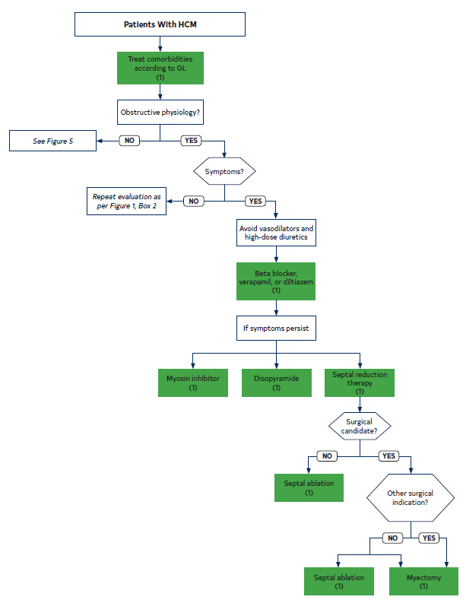
Figure 4. Management of Symptoms in Patients With HCM.
Colors correspond to Table 2.
GL indicates guideline; and HCM, hypertrophic cardiomyopathy.

Slide 73
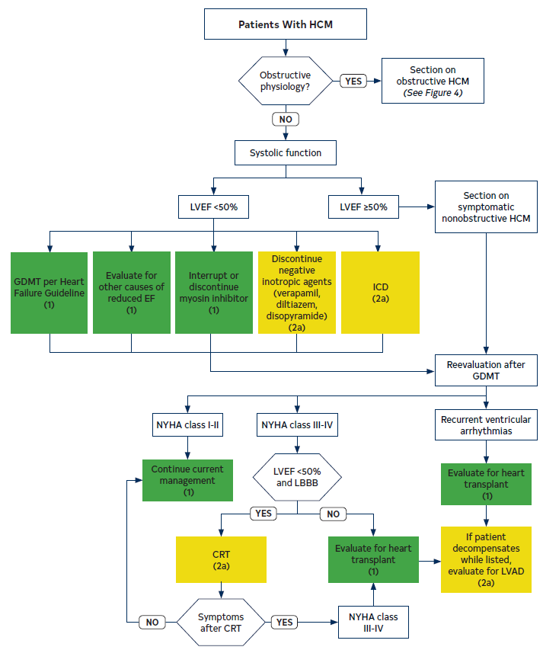
Figure 5. Heart Failure Algorithm.
Cardiac myosin inhibitor should be discontinued if LVEF <50% and can be restarted at a lower dose if the LVEF recovers.
Colors correspond to Table 2.
CRT indicates cardiac resynchronization therapy; EF, ejection fraction; GDMT, guideline-directed management and therapy; HCM, hypertrophic cardiomyopathy; ICD, implantable cardioverter-defibrillator; LBBB, left bundle branch block; LVAD, left ventricular assist device; LVEF, left ventricular ejection fraction; and NYHA, New York Heart Association.

Slide 74
Management of Patients With HCM and AF
Recommendations for Management of Patients With HCM and AF Referenced studies that support the recommendations are summarized in the Online Data Supplement. | Recommendations for Management of Patients With HCM and AF Referenced studies that support the recommendations are summarized in the Online Data Supplement.
COR | LOE | Recommendations
1 | B-NR | In patients with HCM and clinical AF, anticoagulation is recommended with DOACs as first-line option and vitamin K antagonists as second-line option, independent of CHA₂DS₂-VASc score.
1 | C-LD | In patients with HCM and subclinical AF detected by internal or external cardiac device or monitor of >24 hours’ duration for a given episode, anticoagulation is recommended with DOACs as first-line option and vitamin K antagonists as second-line option, independent of CHA₂DS₂-VASc score.
1 | C-LD | In patients with AF in whom rate control strategy is planned, either beta blockers, verapamil, or diltiazem are recommended, with the choice of agents according to patient preferences and comorbid conditions.

Slide 75
Management of Patients With HCM and AF (con’t.)
2a | C-LD | In patients with HCM and subclinical AF detected by internal or external device or monitor, of >5 minutes’ duration but <24 hours’ duration for a given episode, anticoagulation with DOACs as first-line option and vitamin K antagonists as second-line option can be beneficial, taking into consideration duration of AF episodes, total AF burden, underlying risk factors, and bleeding risk.
2a | B-NR | In patients with HCM and poorly tolerated AF, a rhythm-control strategy with cardioversion or antiarrhythmic drugs can be beneficial with the choice of an agent according to AF symptom severity, patient preferences, and comorbid conditions.
2a | B-NR | In patients with HCM and symptomatic AF, as part of an AF rhythm- control strategy, catheter ablation for AF can be effective when drug therapy is ineffective, contraindicated, or not the patient’s preference.
2a | B-NR | In patients with HCM and AF who require surgical myectomy, concomitant surgical AF ablation procedure can be beneficial for AF rhythm control.

Slide 76
Table 8. Antiarrhythmic Drug Therapy Options for Patients With HCM and AF
Antiarrhythmic Drug | Efficacy for AF | Adverse Effects | Toxicities | Use in HCM
Disopyramide | Modest | Anticholinergic HF | Prolonged QTc TdP | Particularly with early onset AF Generally used in conjunction with atrioventricular nodal blocking agents
Flecainide and propafenone | … | Prolonged QRS | Proarrhythmia Typical atrial flutter | Not generally recommended in the absence of an ICD
Sotalol | Modest | Fatigue Bradycardia | Prolonged QTc TdP | Reasonable
Dofetilide | Modest | Headache | Prolonged QTc TdP | Reasonable
Dronedarone | Low | HF | Prolonged QTc | …
Amiodarone | Modest-high | Bradycardia | Liver, lung, thyroid, skin, neurologic Prolonged QTc | Reasonable
AF indicates atrial fibrillation; HCM, hypertrophic cardiomyopathy; HF, heart failure; ICD, implantable cardioverter-defibrillator; and TdP, torsades de pointes.

Slide 77
Management of Patients With HCM and Ventricular Arrhythmias
 | Recommendations for the Management of Patients With HCM and Ventricular Arrhythmias Referenced studies that support the recommendations are summarized in the Online Data Supplement.
COR | LOE | Recommendations
1 | B-NR | In patients with HCM and recurrent, poorly tolerated life-threatening ventricular tachyarrhythmias refractory to maximal antiarrhythmic drug therapy and ablation, heart transplantation assessment is indicated in accordance with current listing criteria.
1 | B-NR* | In adults with HCM and symptomatic ventricular arrhythmias or recurrent ICD shocks despite beta-blocker use, antiarrhythmic drug therapy (eg, amiodarone,* dofetilide,† mexiletine,† or sotalol†) is recommended, with the choice of agent guided by age, underlying comorbidities, severity of disease, patient preferences, and balance between efficacy and safety.
 | C-LD†
*indicates the LOE for amiodarone. †Indicates the LOE for dofetilide, mexiletine, or sotalol.

Slide 78
Management of Patients With HCM and Ventricular Arrhythmias (con’t.)
1 | C-LD | In children with HCM and recurrent ventricular arrhythmias despite beta-blocker use, antiarrhythmic drug therapy (eg, amiodarone, mexiletine, sotalol) is recommended, with the choice of agent guided by age, underlying comorbidities, severity of disease, patient preferences, and balance of efficacy and safety.
1 | C-LD | In patients with HCM and pacing-capable ICDs, programming antitachycardia pacing is recommended to minimize risk of shocks.
2a | C-LD | In patients with HCM and recurrent symptomatic sustained monomorphic VT, or recurrent ICD shocks despite optimal device programming, and in whom antiarrhythmic drug therapy is either ineffective, not tolerated, or not preferred, catheter ablation can be useful for reducing arrhythmia burden.

Slide 79
Lifestyle Considerations for Patients With HCM

Slide 80
Recreational Physical Activity and Competitive Sports
Recommendations for Recreational Physical Activity and Competitive Sports Referenced studies that support the recommendations are summarized in the Online Data Supplement. | Recommendations for Recreational Physical Activity and Competitive Sports Referenced studies that support the recommendations are summarized in the Online Data Supplement.
COR | LOE | Recommendations
1 | B-R | For patients with HCM, mild- to moderate-intensity* recreational† exercise is beneficial to improve cardiorespiratory fitness, physical functioning, and quality of life, and for overall health in keeping with physical activity guidelines for the general population.
1 | C-EO | For athletes with HCM, a comprehensive evaluation and shared decision-making about sports participation with an expert professional is recommended.
2a | B-NR | In individuals who are genotype-positive, phenotype-negative for HCM, participation in competitive sports of any intensity is reasonable.
*Exercise intensity can be gauged by METS: light <3 METs, moderate 3–6 METs, and vigorous >6 METs, by % maximum heart rate achieved (light 40%–50%, moderate 50%–70%, vigorous >70%), or by level of perceived exertion on the Borg scale (light 7–12, moderate 13–14, vigorous ≥15).
†Recreational exercise is done for the purpose of leisure with no requirement for systematic training and without the purpose to excel or compete against others. Competitive sports involve systematic training for the primary purpose of competition against others, at multiple levels, including high school, collegiate, master’s level, semiprofessional, or professional sporting activities.

Slide 81
Recreational Physical Activity and Competitive Sports (con’t.)
2a | B-NR | For patients with HCM, participation in vigorous* recreational activities is reasonable after an annual comprehensive evaluation and shared decision-making with an expert professional who balances potential benefits and risks.
2b | B-NR | For patients with HCM who are capable of a high level of physical performance, participation in competitive sports† may be considered after review by an expert provider with experience managing athletes with HCM who conducts an annual comprehensive evaluation and shared decision-making that balances potential benefits and risks.
3: No benefit | B-NR | For most patients with HCM, universal restriction from vigorous physical activity or competitive sports is not indicated.
3: Harm | C-EO | In patients with HCM, ICD placement for the sole purpose of participation in competitive sports should not be performed.
*Exercise intensity can be gauged by METs: light <3 METs, moderate 3–6 METs, and vigorous >6 METs, by % maximum heart rate achieved (light 40%–50%, moderate 50%–70%, vigorous >70%), or by level of perceived exertion on the Borg scale (light 7–12, moderate 13–14, vigorous ≥15).
†Recreational exercise is done for the purpose of leisure with no requirement for systematic training and without the purpose to excel or compete against others. Competitive sports involve systematic training for the primary purpose of competition against others, at multiple levels, including high school, collegiate, master’s level, semiprofessional, or professional sporting activities.

Slide 82
Occupation in Patients With HCM
Recommendations for Occupation in Patients With HCM | Recommendations for Occupation in Patients With HCM
COR | LOE | Recommendations
2a | C-EO | For patients with HCM, it is reasonable to follow Federal Motor Carrier Safety Administration cardiovascular disease guidelines that permit driving commercial motor vehicles, if they do not have an ICD or any major risk factors for SCD and are using a GDMT plan.
2a | C-EO | For pilot aircrew with a diagnosis of HCM, it is reasonable to follow Federal Aviation Administration guidelines that permit consideration of multicrew flying duties, provided they are asymptomatic, are deemed low risk for SCD, and can complete a maximal treadmill stress test at 85% peak heart rate.
2b | C-EO | It is reasonable for patients with HCM to consider occupations that require manual labor, heavy lifting, or a high level of physical performance after a comprehensive clinical evaluation, risk stratification for SCD, and implementation of GDMT in the context of shared decision-making.

Slide 83
Pregnancy in Patients With HCM
 | Recommendations for Pregnancy in Patients With HCM Referenced studies that support the recommendations are summarized in the Online Data Supplement.
COR | LOE | Recommendations
1 | B-NR | For pregnant women with HCM and AF or other indications for anticoagulation, low-molecular-weight heparin or vitamin K antagonists (at maximum therapeutic dose of <5 mg daily) are recommended for stroke prevention.
1 | C-LD | In pregnant women with HCM, selected beta blockers should be administered for symptoms related to outflow tract obstruction or arrhythmias, with monitoring of fetal growth.
1 | C-LD | In most pregnant women with HCM, vaginal delivery is recommended as the first-choice delivery option.
1 | B-NR | In affected families with HCM, preconceptional and prenatal reproductive and genetic counseling should be offered.
1 | C-EO | For pregnant women with HCM, care should be coordinated between their cardiologist and an obstetrician. For patients with HCM who are deemed high risk, consultation is advised with an expert in maternal-fetal medicine.

Slide 84
Pregnancy in Patients With HCM (con’t.)
2a | C-LD | For women with clinically stable HCM who wish to become pregnant, it is reasonable to advise that pregnancy is generally safe as part of a shared discussion regarding potential maternal and fetal risks, and initiation of GDMT.
2a | C-LD | In pregnant women with HCM, cardioversion for new or recurrent AF, particularly if symptomatic, is reasonable.
2a | C-LD | In pregnant women with HCM, general or epidural anesthesia is reasonable, with precautions to avoid hypotension.
2a | C-EO | In pregnant women with HCM, it is reasonable to perform serial echocardiography, particularly during the second or third trimester when hemodynamic load is highest, or if clinical symptoms develop.
2b | C-EO | In pregnant women with HCM, fetal echocardiography may be considered for diagnosis of fetal HCM in the context of prenatal counseling.
3: Harm | C-EO | In pregnant women, use of mavacamten is contraindicated due to potential teratogenic effects.

Slide 85
Patients With Comorbidities
 | Recommendations for Patients With Comorbidities Referenced studies that support the recommendations are summarized in the Online Data Supplement.
COR | LOE | Recommendations
1 | C-EO | In patients with HCM, adherence to the ACC/AHA primary prevention guideline is recommended to reduce risk of cardiovascular events.
1 | B-NR | In patients with HCM who are overweight or obese, counseling and comprehensive lifestyle interventions are recommended for achieving and maintaining weight loss and possibly lowering the risk of developing LVOTO, HF, and AF.
1 | C-LD | In patients with HCM and hypertension, lifestyle modifications and medical therapy for hypertension are recommended, with preference for beta blockers and nondihydropyridine calcium channel blockers in patients with obstructive HCM.
1 | C-LD | In patients with HCM, assessment for symptoms of sleep-disordered breathing is recommended and, if present, referral to a sleep medicine specialist for evaluation and treatment is recommended.

Slide 86
Abbreviations
Abbreviation | Meaning/Phrase
AF | atrial fibrillation
CAD | coronary artery disease
CMR | cardiovascular magnetic resonance
CPET | cardiopulmonary exercise test
CRT | cardiac resynchronization therapy
DOAC | direct-acting oral anticoagulants
EF | ejection fraction
ESM | extended septal myectomy
GDMT | guideline-directed management and therapy
HCM | hypertrophic cardiomyopathy
HF | heart failure
ICD | implantable cardioverter-defibrillator
LBBB | left bundle branch block
LGE | late gadolinium enhancement
LV | left ventricular
LVAD | left ventricular assist device
LVEF | left ventricular ejection fraction

Slide 87
Abbreviation | Meaning/Phrase
LVH | left ventricular hypertrophy
LVOT | left ventricular outflow tract
LVOTO | left ventricular outflow tract obstruction
MET | metabolic equivalent
MR | mitral regurgitation
NSVT | nonsustained ventricular tachycardia
NYHA | New York Heart Association
RCT | randomized controlled trial
RV | right ventricular
SAM | systolic anterior motion
SCAF | subclinical atrial fibrillation
SCD | sudden cardiac death
SRT | septal reduction therapy
TEE | transesophageal echocardiogram
TTE | transthoracic echocardiogram
VF | ventricular fibrillation
VT | ventricular tachycardia
VUS | variant of uncertain significance
Abbreviations (con’t.)

