Slide 1
2019 AHA/ACC/HRS Focused Update of the 2014 AHA/ACC/HRS Guideline for the Management of Patients With Atrial Fibrillation
Developed in Collaboration With the Society of Thoracic Surgeons
© American College of Cardiology Foundation and American Heart Association

Slide 2
Citation
This slide set is adapted from the 2019 AHA/ACC/HRS Focused Update of the 2014 AHA/ACC/HRS Guideline for the Management of Patients with Atrial Fibrillation. Published on January 28, 2019, available at: Journal of the American College of Cardiology [(insert full link)] and Circulation [(insert full link)]
The full-text guidelines are also available on the following Web sites: ACC (www.acc.org) and
AHA (professional.heart.org)

Slide 3
Writing Committee
Craig T. January, MD, PhD, FACC, Chair
L. Samuel Wann, MD, FACC, FAHA, Vice Chair
Hugh Calkins, MD, FACC, FAHA, FHRS*†
Lin Y. Chen, MD, MS, FACC, FAHA, FHRS†
Joaquin E. Cigarroa, MD, FACC‡
Joseph C. Cleveland, Jr, MD, FACC*§
Patrick T. Ellinor, MD, PhD*†
Michael D. Ezekowitz, MBChB, DPhil, FACC, FAHA*║
Hugh Calkins, MD, FACC, FAHA, FHRS*†
Lin Y. Chen, MD, MS, FACC, FAHA, FHRS†
Michael E. Field, MD, FACC, FAHA, FHRS║
Karen L. Furie, MD, MPH, FAHA║
Paul A. Heidenreich, MD, FACC, FAHA¶
Katherine T. Murray, MD, FACC, FAHA, FHRS║
Julie B. Shea, MS, RNCS, FHRS*║
Cynthia M. Tracy, MD, FAHA*║
Michael E. Field, MD, FACC, FAHA, FHRS║
Karen L. Furie, MD, MPH, FAHA║ Clyde W. Yancy, MD, MACC, FAHA║
‡ACC/AHA Task Force on Clinical Practice Guidelines Liaison. ║ACC/AHA Representative. †HRS Representative. §STS Representative. ¶ACC/AHA Task Force on Performance Measures Representative.

Slide 4
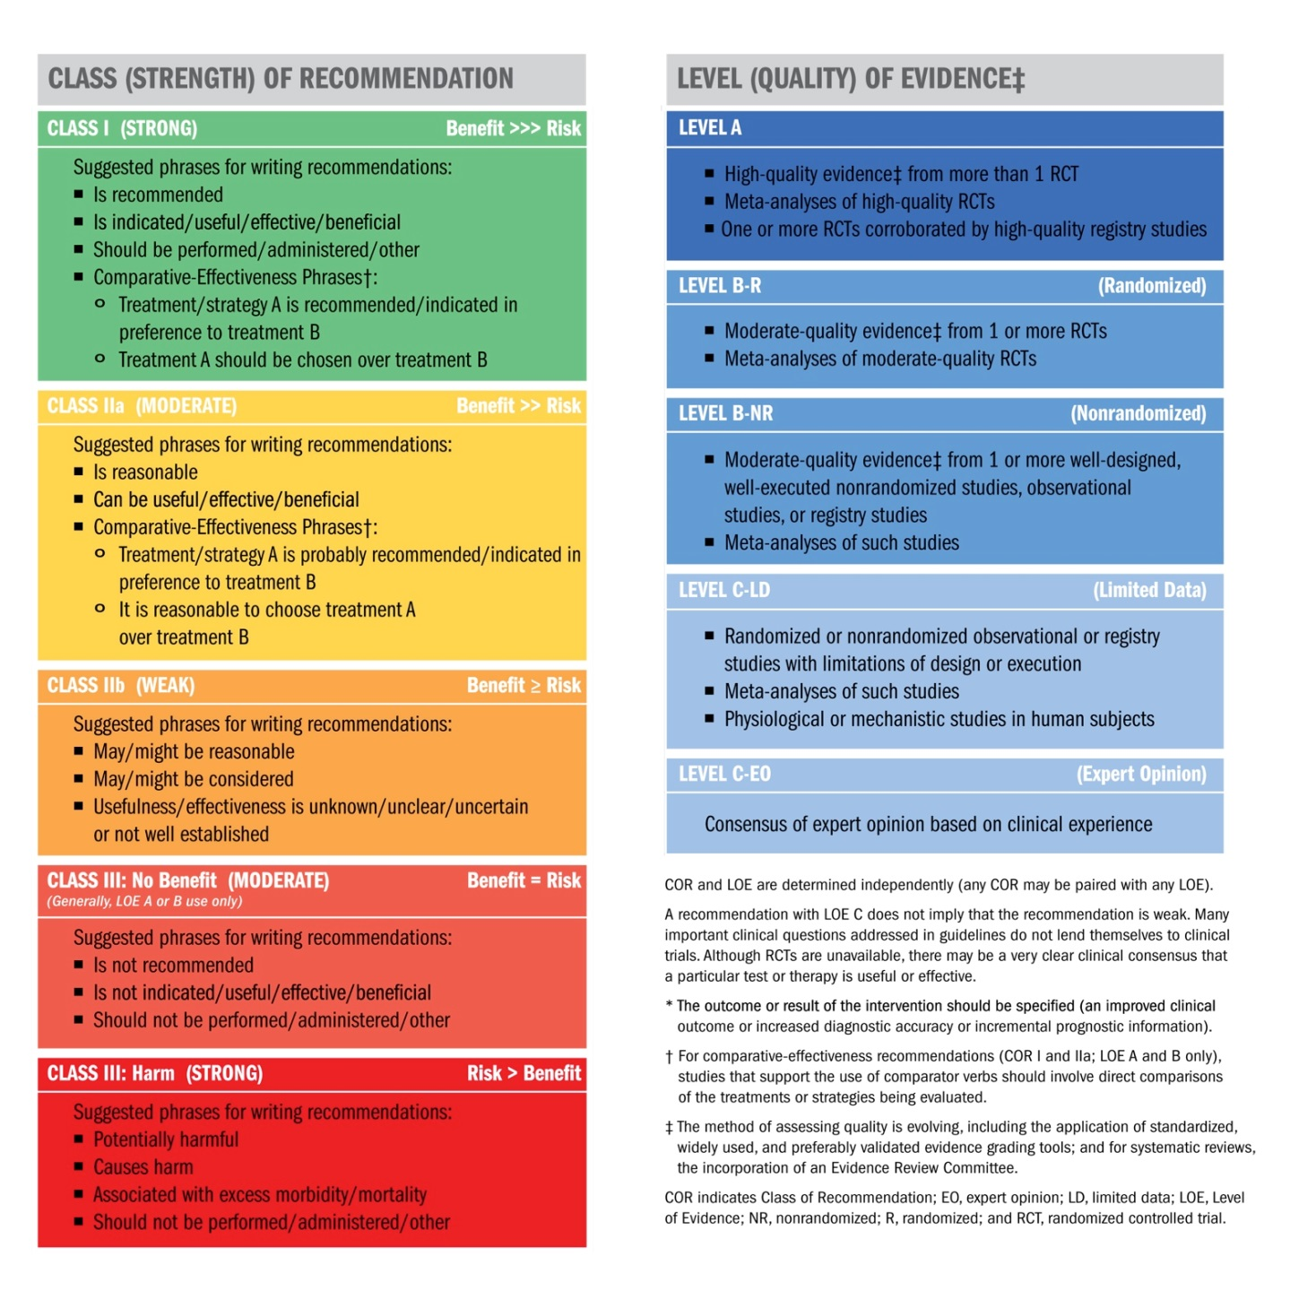
Table 1. Applying Class of Recommendation and Level of Evidence to Clinical Strategies, Interventions, Treatments, or Diagnostic Testing
in Patient Care*
(Updated August 2015)
Notes:
MC note: Second formatting option

Slide 5
2019 Focused Update on Atrial Fibrillation
Recommendations for Selecting an Anticoagulant Regimen—Balancing Risks and Benefits

Slide 6
Anticoagulation Regimen – Balancing Risks and Benefits
Recommendations for Selecting an Anticoagulant Regimen—Balancing Risks and Benefits
COR | LOE | Recommendations
I | A | For patients with AF and an elevated CHA₂DS₂-VASc score of 2 or greater in men or 3 or greater in women, oral anticoagulants are recommended. Options include: Warfarin (LOE: A) Dabigatran (LOE: B) Rivaroxaban (LOE: B) Apixaban (LOE: B) or Edoxaban (LOE: B-R) MODIFIED: This recommendation has been updated in response to the approval of edoxaban, a new factor Xa inhibitor. More precision in the use of CHA₂DS₂-VASc scores is specified in subsequent recommendations. The LOEs for warfarin, dabigatran, rivaroxaban, and apixaban have not been updated for greater granularity as per the new LOE system. (Section 4.1. in the 2014 AF Guideline) The original text can be found in Section 4.1 of the 2014 AF guideline. Additional information about the comparative effectiveness and bleeding risk of NOACs can be found in Section 4.2.2.2.
 | B
 | B
 | B
 | B-R

Slide 7
Anticoagulation Regimen – Balancing Risks and Benefits
Recommendations for Selecting an Anticoagulant Regimen—Balancing Risks and Benefits
COR | LOE | Recommendations
I | A | NOACs (dabigatran, rivaroxaban, apixaban, and edoxaban) are recommended over warfarin in NOAC-eligible patients with AF (except with moderate-to-severe mitral stenosis or a mechanical heart valve). NEW: Exclusion criteria are now defined as moderate-to-severe mitral stenosis or a mechanical heart valve. When the NOAC trials are considered as a group, the direct thrombin inhibitor and factor Xa inhibitors were at least noninferior and, in some trials, superior to warfarin for preventing stroke and systemic embolism and were associated with lower risks of serious bleeding.

Slide 8
Anticoagulation Regimen – Balancing Risks and Benefits
Recommendations for Selecting an Anticoagulant Regimen—Balancing Risks and Benefits
COR | LOE | Recommendations
I | A | Among patients treated with warfarin, the international normalized ratio (INR) should be determined at least weekly during initiation of anticoagulant therapy and at least monthly when anticoagulation (INR in range) is stable. MODIFIED: “Antithrombotic” was changed to “anticoagulant.”

Slide 9
Anticoagulation Regimen – Balancing Risks and Benefits
Recommendations for Selecting an Anticoagulant Regimen—Balancing Risks and Benefits
COR | LOE | Recommendations
I | B | In patients with AF (except with moderate-to-severe mitral stenosis or a mechanical heart valve), the CHA₂DS₂-VASc score is recommended for assessment of stroke risk. MODIFIED: Exclusion criteria are now defined as moderate-to-severe mitral stenosis or a mechanical heart valve. Patients with AF with bioprosthetic heart valves are addressed in the supportive text. (Section 4.1. in the 2014 AF guideline)

Slide 10
Anticoagulation Regimen – Balancing Risks and Benefits
Recommendations for Selecting an Anticoagulant Regimen—Balancing Risks and Benefits
COR | LOE | Recommendations
I | B | For patients with AF who have mechanical heart valves, warfarin is recommended. MODIFIED: New information is included in the supportive text.

Slide 11
Anticoagulation Regimen – Balancing Risks and Benefits
Recommendations for Selecting an Anticoagulant Regimen—Balancing Risks and Benefits
COR | LOE | Recommendations
I | B | Selection of anticoagulant therapy should be based on the risk of thromboembolism, irrespective of whether the AF pattern is paroxysmal, persistent, or permanent. MODIFIED: “Antithrombotic” was changed to “anticoagulant.”

Slide 12
Anticoagulation Regimen – Balancing Risks and Benefits
Recommendations for Selecting an Anticoagulant Regimen—Balancing Risks and Benefits
COR | LOE | Recommendations
I | B-NR | Renal function and hepatic function should be evaluated before initiation of a NOAC and should be reevaluated at least annually. MODIFIED: Evaluation of hepatic function was added. LOE was updated from B to B-NR. New evidence was added. (Section 4.1. in the 2014 AF Guideline)

Slide 13
Anticoagulation Regimen – Balancing Risks and Benefits
Recommendations for Selecting an Anticoagulant Regimen—Balancing Risks and Benefits
COR | LOE | Recommendations
I | C | In patients with AF, anticoagulant therapy should be individualized on the basis of shared decision-making after discussion of the absolute risks and relative risks of stroke and bleeding, as well as the patient’s values and preferences. MODIFIED: “Antithrombotic” was changed to “anticoagulant.”

Slide 14
Anticoagulation Regimen – Balancing Risks and Benefits
Recommendations for Selecting an Anticoagulant Regimen—Balancing Risks and Benefits
COR | LOE | Recommendations
I | C | For patients with atrial flutter, anticoagulant therapy is recommended according to the same risk profile used for AF. MODIFIED: “Antithrombotic” was changed to “anticoagulant.”

Slide 15
Anticoagulation Regimen – Balancing Risks and Benefits
Recommendations for Selecting an Anticoagulant Regimen—Balancing Risks and Benefits
COR | LOE | Recommendations
I | C | Reevaluation of the need for and choice of anticoagulant therapy at periodic intervals is recommended to reassess stroke and bleeding risks. MODIFIED: “Antithrombotic” was changed to “anticoagulant.”

Slide 16
Anticoagulation Regimen – Balancing Risks and Benefits
Recommendations for Selecting an Anticoagulant Regimen—Balancing Risks and Benefits
COR | LOE | Recommendations
I | C-EO | For patients with AF (except with moderate-to-severe mitral stenosis or a mechanical heart valve) who are unable to maintain a therapeutic INR level with warfarin, use of a NOAC is recommended. MODIFIED: Exclusion criteria are now defined as moderate-to-severe mitral stenosis or a mechanical heart valve, and this recommendation has been changed in response to the approval of edoxaban. (Section 4.1. in the 2014 AF Guideline)

Slide 17
Anticoagulation Regimen – Balancing Risks and Benefits
Recommendations for Selecting an Anticoagulant Regimen—Balancing Risks and Benefits
COR | LOE | Recommendations
IIa | B | For patients with AF (except with moderate-to-severe mitral stenosis or a mechanical heart valve) and a CHA₂DS₂-VASc score of 0 in men or 1 in women, it is reasonable to omit anticoagulant therapy. MODIFIED: Exclusion criteria are now defined as moderate-to-severe mitral stenosis or a mechanical heart valve. (Section 4.1. in the 2014 AF Guideline)

Slide 18
Anticoagulation Regimen – Balancing Risks and Benefits
Recommendations for Selecting an Anticoagulant Regimen—Balancing Risks and Benefits
COR | LOE | Recommendations
IIb | B-NR | For patients with AF who have a CHA₂DS₂-VASc score of 2 or greater in men or 3 or greater in women and who have end-stage chronic kidney disease (CKD; creatinine clearance [CrCl] <15 mL/min) or are on dialysis, it might be reasonable to prescribe warfarin (INR 2.0 to 3.0) or apixaban for oral anticoagulation. MODIFIED: New evidence has been added. LOE was updated from B to B-NR. (Section 4.1. in the 2014 AF Guideline)

Slide 19
Anticoagulation Regimen – Balancing Risks and Benefits
Recommendations for Selecting an Anticoagulant Regimen—Balancing Risks and Benefits
COR | LOE | Recommendations
IIb | B-R | For patients with AF (except with moderate-to-severe mitral stenosis or a mechanical heart valve) and moderate-to-severe CKD (serum creatinine ≥1.5 mg/dL [apixaban], CrCl 15 to 30 mL/min [dabigatran], CrCl <50 mL/min [rivaroxaban], or CrCl 15 to 50 mL/min [edoxaban]) with an elevated CHA₂DS₂-VASc score, treatment with reduced doses of direct thrombin or factor Xa inhibitors may be considered (e.g., dabigatran, rivaroxaban, apixaban, or edoxaban). MODIFIED: Exclusion criteria are now defined as moderate-to-severe mitral stenosis or a mechanical heart valve, and this recommendation has been changed in response to the approval of edoxaban. LOE was updated from C to B-R. (Section 4.1. in the 2014 AF Guideline)

Slide 20
Anticoagulation Regimen – Balancing Risks and Benefits
Recommendations for Selecting an Anticoagulant Regimen—Balancing Risks and Benefits
COR | LOE | Recommendations
IIb | C- LD | For patients with AF (except with moderate-to-severe mitral stenosis or a mechanical heart valve) and a CHA₂DS₂-VASc score of 1 in men and 2 in women, prescribing an oral anticoagulant to reduce thromboembolic stroke risk may be considered. MODIFIED: Exclusion criteria are now defined as moderate-to-severe mitral stenosis or a mechanical heart valve, and evidence was added to support separate risk scores by sex. LOE was updated from C to C-LD. (Section 4.1. in the 2014 AF Guideline)

Slide 21
Anticoagulation Regimen – Balancing Risks and Benefits
Recommendations for Selecting an Anticoagulant Regimen—Balancing Risks and Benefits
COR | LOE | Recommendations
III: No Benefit | C-EO | In patients with AF and end-stage CKD or on dialysis, the direct thrombin inhibitor dabigatran or the factor Xa inhibitors rivaroxaban or edoxaban are not recommended because of the lack of evidence from clinical trials that benefit exceeds risk. MODIFIED: New data have been included. Edoxaban received FDA approval and has been added to the recommendation. LOE was updated from C to C-EO. (Section 4.1. in the 2014 AF Guideline)

Slide 22
Anticoagulation Regimen – Balancing Risks and Benefits
Recommendations for Selecting an Anticoagulant Regimen—Balancing Risks and Benefits
COR | LOE | Recommendations
III: Harm | B-R | The direct thrombin inhibitor dabigatran should not be used in patients with AF and a mechanical heart valve. MODIFIED: Evidence was added. LOE was updated from B to B-R. Other NOACs are addressed in the supportive text. (Section 4.1. in the 2014 AF Guideline)

Slide 23
2019 Focused Update on Atrial Fibrillation
Interruption and Bridging Anticoagulation

Slide 24
Interruption and Bridging Anticoagulation
Recommendations for Interruption and Bridging Anticoagulation
COR | LOE | Recommendations
I | C | Bridging therapy with unfractionated heparin or low-molecular-weight heparin is recommended for patients with AF and a mechanical heart valve undergoing procedures that require interruption of warfarin. Decisions on bridging therapy should balance the risks of stroke and bleeding.
I | B-R | For patients with AF without mechanical heart valves who require interruption of warfarin for procedures, decisions about bridging therapy (unfractionated heparin or low-molecular-weight heparin) should balance the risks of stroke and bleeding and the duration of time a patient will not be anticoagulated. MODIFIED: LOE was updated from C to B-R because of new evidence. (Section 4.1. in the 2014 AF Guideline)

Slide 25
Interruption and Bridging Anticoagulation
Recommendations for Interruption and Bridging Anticoagulation
COR | LOE | Recommendations
I | B-NR | Idarucizumab is recommended for the reversal of dabigatran in the event of life-threatening bleeding or an urgent procedure. NEW: New evidence has been published about idarucizumab to support LOE B-NR.
IIa | B-NR | Andexanet alfa can be useful for the reversal of rivaroxaban and apixaban in the event of life-threatening or uncontrolled bleeding. NEW: New evidence has been published about andexanet alfa to support LOE B-NR.

Slide 26
2019 Focused Update on Atrial Fibrillation
Nonpharmacological Stroke Prevention

Slide 27
Percutaneous Approaches to Occlude the LAA
Recommendation for Percutaneous Approaches to Occlude the LAA
COR | LOE | Recommendation
IIb | B-NR | Percutaneous LAA occlusion may be considered in patients with AF at increased risk of stroke who have contraindications to long-term anticoagulation. NEW: Clinical trial data and FDA approval of the Watchman device necessitated this recommendation.

Slide 28
Cardiac Surgery – LAA Occlusion/Excision
Recommendation for Cardiac Surgery—LAA Occlusion/Excision
COR | LOE | Recommendation
IIb | B-NR | Surgical occlusion of the LAA may be considered in patients with AF undergoing cardiac surgery, as a component of an overall heart team approach to the management of AF. MODIFIED: LOE was updated from C to B-NR because of new evidence.

Slide 29
2019 Focused Update on Atrial Fibrillation
Rhythm Control

Slide 30
Prevention of Thromboembolism
Recommendations for Prevention of Thromboembolism
COR | LOE | Recommendations
I | B-R | For patients with AF or atrial flutter of 48 hours’ duration or longer, or when the duration of AF is unknown, anticoagulation with warfarin (INR 2.0 to 3.0), a factor Xa inhibitor, or direct thrombin inhibitor is recommended for at least 3 weeks before and at least 4 weeks after cardioversion, regardless of the CHA₂DS₂-VASc score or the method (electrical or pharmacological) used to restore sinus rhythm. MODIFIED: The 2014 AF Guideline recommendation for use of warfarin around the time of cardioversion was combined with the 2014 AF Guideline recommendation for NOACs to create a single recommendation. This combined recommendation was updated to COR I/LOE B-R from COR IIa/LOE C for NOACs in the 2014 AF Guideline on the basis of additional trials that have evaluated the use of NOACs with cardioversion.
I | C | For patients with AF or atrial flutter of more than 48 hours’ duration or unknown duration that requires immediate cardioversion for hemodynamic instability, anticoagulation should be initiated as soon as possible and continued for at least 4 weeks after cardioversion unless contraindicated.

Slide 31
Prevention of Thromboembolism
Recommendations for Prevention of Thromboembolism
COR | LOE | Recommendations
I | C-EO | After cardioversion for AF of any duration, the decision about long-term anticoagulation therapy should be based on the thromboembolic risk profile and bleeding risk profile. MODIFIED: The 2014 AF Guideline recommendation was strengthened with the addition of bleeding risk profile to the long-term anticoagulation decision-making process.
IIa | B-NR | For patients with AF or atrial flutter of less than 48 hours’ duration with a CHA₂DS₂-VASc score of 2 or greater in men and 3 or greater in women, administration of heparin, a factor Xa inhibitor, or a direct thrombin inhibitor is reasonable as soon as possible before cardioversion, followed by long-term anticoagulation therapy. MODIFIED: Recommendation COR was changed from I in the 2014 AF Guideline to IIa, and LOE was changed from C in the 2014 AF Guideline to B-NR. In addition, a specific CHA₂DS₂-VASc score is now specified.

Slide 32
Prevention of Thromboembolism
Recommendations for Prevention of Thromboembolism
COR | LOE | Recommendations
IIa | B | For patients with AF or atrial flutter of 48 hours’ duration or longer or of unknown duration who have not been anticoagulated for the preceding 3 weeks, it is reasonable to perform transesophageal echocardiography before cardioversion and proceed with cardioversion if no left atrial thrombus is identified, including in the LAA, provided that anticoagulation is achieved before transesophageal echocardiography and maintained after cardioversion for at least 4 weeks.
IIb | B-NR | For patients with AF or atrial flutter of less than 48 hours’ duration with a CHA₂DS₂-VASc score of 0 in men or 1 in women, administration of heparin, a factor Xa inhibitor, or a direct thrombin inhibitor, versus no anticoagulant therapy, may be considered before cardioversion, without the need for postcardioversion oral anticoagulation. MODIFIED: Recommendation LOE was changed from C in the 2014 AF Guideline to B-NR to reflect evidence from 2 registry studies and to include specific CHA₂DS₂-VASc scores derived from study results.

Slide 33
2019 Focused Update on Atrial Fibrillation
AF Catheter Ablation to Maintain Sinus Rhythm

Slide 34
Catheter Ablation in HF
Recommendation for Catheter Ablation in HF
COR | LOE | Recommendation
IIb | B-R | AF catheter ablation may be reasonable in selected patients with symptomatic AF and HF with reduced left ventricular (LV) ejection fraction (HFrEF) to potentially lower mortality rate and reduce hospitalization for HF. NEW: New evidence, including data on improved mortality rate, has been published for AF catheter ablation compared with medical therapy in patients with HF.

Slide 35
2019 Focused Update on Atrial Fibrillation
Specific Patient Groups and AF

Slide 36
AF Complicating ACS
Recommendations for AF Complicating ACS
COR | LOE | Recommendations
I | B-R | For patients with ACS and AF at increased risk of systemic thromboembolism (based on CHA₂DS₂-VASc risk score of 2 or greater), anticoagulation is recommended unless the bleeding risk exceeds the expected benefit. MODIFIED: New published data are available. LOE was updated from C in the 2014 AF Guideline to B-R. Anticoagulation options are described in supportive text.
I | C | Urgent direct-current cardioversion of new-onset AF in the setting of ACS is recommended for patients with hemodynamic compromise, ongoing ischemia, or inadequate rate control.
Notes:
SR indicates systematic review.

Slide 37
AF Complicating ACS
Recommendations for AF Complicating ACS
COR | LOE | Recommendations
I | C | Intravenous beta blockers are recommended to slow a rapid ventricular response to AF in patients with ACS who do not display HF, hemodynamic instability, or bronchospasm.
IIa | B-NR | If triple therapy (oral anticoagulant, aspirin, and P2Y₁₂ inhibitor) is prescribed for patients with AF at increased risk of stroke (based on CHA₂DS₂-VASc risk score of 2 or greater) who have undergone percutaneous coronary intervention (PCI) with stenting for ACS, it is reasonable to choose clopidogrel in preference to prasugrel. NEW: New published data are available.
Notes:
SR indicates systematic review.

Slide 38
AF Complicating ACS
Recommendations for AF Complicating ACS
COR | LOE | Recommendations
IIa | B-R | In patents with AF at increased risk of stroke (based on CHA₂DS₂-VASc risk score of 2 or greater) who have undergone PCI with stenting for ACS, double therapy with a P2Y₁₂ inhibitor (clopidogrel or ticagrelor) and dose-adjusted vitamin K antagonist is reasonable to reduce the risk of bleeding as compared with triple therapy. NEW: New RCT data and data from 2 registries and a retrospective cohort study are available.
IIa | B-R | In patients with AF at increased risk of stroke (based on CHA₂DS₂-VASc risk score of 2 or greater) who have undergone PCI with stenting for ACS, double therapy with P2Y₁₂ inhibitors (clopidogrel) and low-dose rivaroxaban 15 mg daily is reasonable to reduce the risk of bleeding as compared with triple therapy. NEW: New published data are available.
Notes:
SR indicates systematic review.

Slide 39
AF Complicating ACS
Recommendations for AF Complicating ACS
COR | LOE | Recommendations
IIa | B-R | In patients with AF at increased risk of stroke (based on CHA₂DS₂-VASc risk score of 2 or greater) who have undergone PCI with stenting for ACS, double therapy with a P2Y₁₂ inhibitor (clopidogrel) and dabigatran 150 mg twice daily is reasonable to reduce the risk of bleeding as compared with triple therapy. NEW: New published data are available.
IIb | B-R | If triple therapy (oral anticoagulant, aspirin, and P2Y₁₂ inhibitor) is prescribed for patients with AF who are at increased risk of stroke (based on CHA₂DS₂-VASc risk score of 2 or greater) and who have undergone PCI with stenting (drug eluting or bare metal) for ACS, a transition to double therapy (oral anticoagulant and P2Y₁₂ inhibitor) at 4 to 6 weeks may be considered. NEW: New published data are available.
Notes:
SR indicates systematic review.

Slide 40
AF Complicating ACS
Recommendations for AF Complicating ACS
COR | LOE | Recommendations
IIb | C | Administration of amiodarone or digoxin may be considered to slow a rapid ventricular response in patients with ACS and AF associated with severe LV dysfunction and HF or hemodynamic instability.
IIb | C | Administration of nondihydropyridine calcium antagonists may be considered to slow a rapid ventricular response in patients with ACS and AF only in the absence of significant HF or hemodynamic instability.
Notes:
SR indicates systematic review.

Slide 41
Device Detection of AF and Atrial Flutter (New)
Recommendations for Device Detection of AF and Atrial Flutter
COR | LOE | Recommendations
I | B-NR | In patients with cardiac implantable electronic devices (pacemakers or implanted cardioverter-defibrillators), the presence of recorded atrial high-rate episodes (AHREs) should prompt further evaluation to document clinically relevant AF to guide treatment decisions.
IIa | B-R | In patients with cryptogenic stroke (i.e., stroke of unknown cause) in whom external ambulatory monitoring is inconclusive, implantation of a cardiac monitor (loop recorder) is reasonable to optimize detection of silent AF.
Notes:
SR indicates systematic review.

Slide 42
Weight Loss (New)
Recommendation for Weight Loss in Patients with AF
COR | LOE | Recommendation
I | B-R | For overweight and obese patients with AF, weight loss, combined with risk factor modification, is recommended. NEW: New data demonstrate the beneficial effects of weight loss and risk factor modification on controlling AF.
Notes:
SR indicates systematic review.

